Slide 1

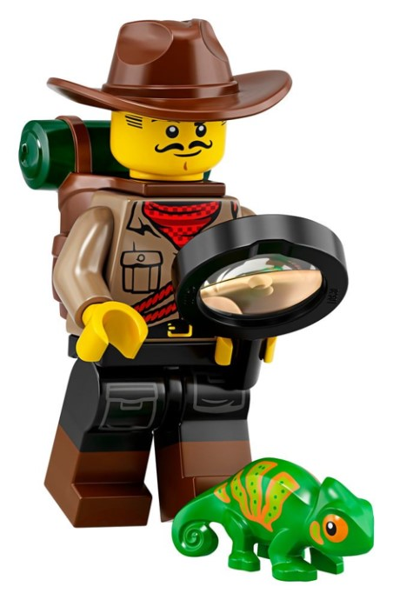
3rd and 4th Grade
Challenge Team
Coach Vicky
Coach Jim
Coach Brian
Coach Rebekah
Coach Dillon
Coach Alla
Coach Robert
Coach John
Coach Ayesh
Coach Jennie
Coach Levi

Slide 2
Welcome Archeologists
What is Archeology?

Slide 3
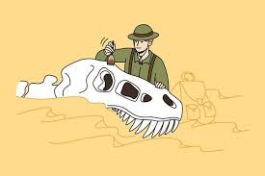


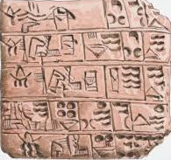

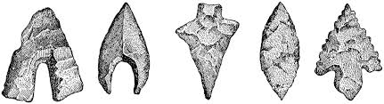
Paleontologist
Studies Fossils
(remains of plants and animals)
Geology
Study Earth soil, minerals, rocks
Archeologist
Studies stuff
PEOPLE left behind

Slide 4





Slide 5
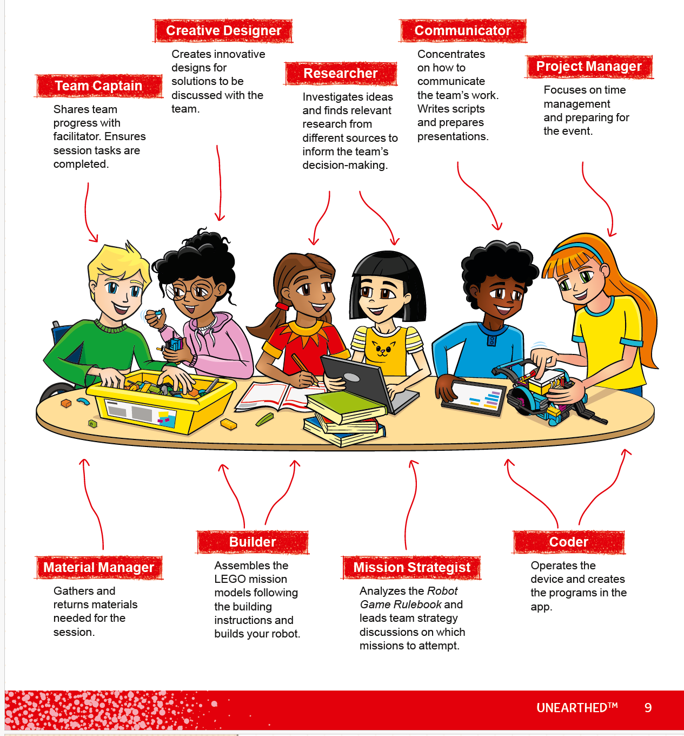
Selecting Teams
4 Teams
6-8 team members each team
3 robots per team
1 Robot for competition, back up
Teamwork, Inclusive
Each team selects name
Each team different shirts

Slide 6
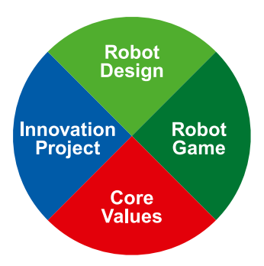
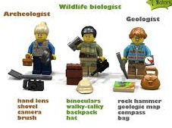
What is a First Lego League Challenge Team?
Core Values – Fun, Teamwork
Innovative Project
Robot Design
Robot Mission Game

Slide 7
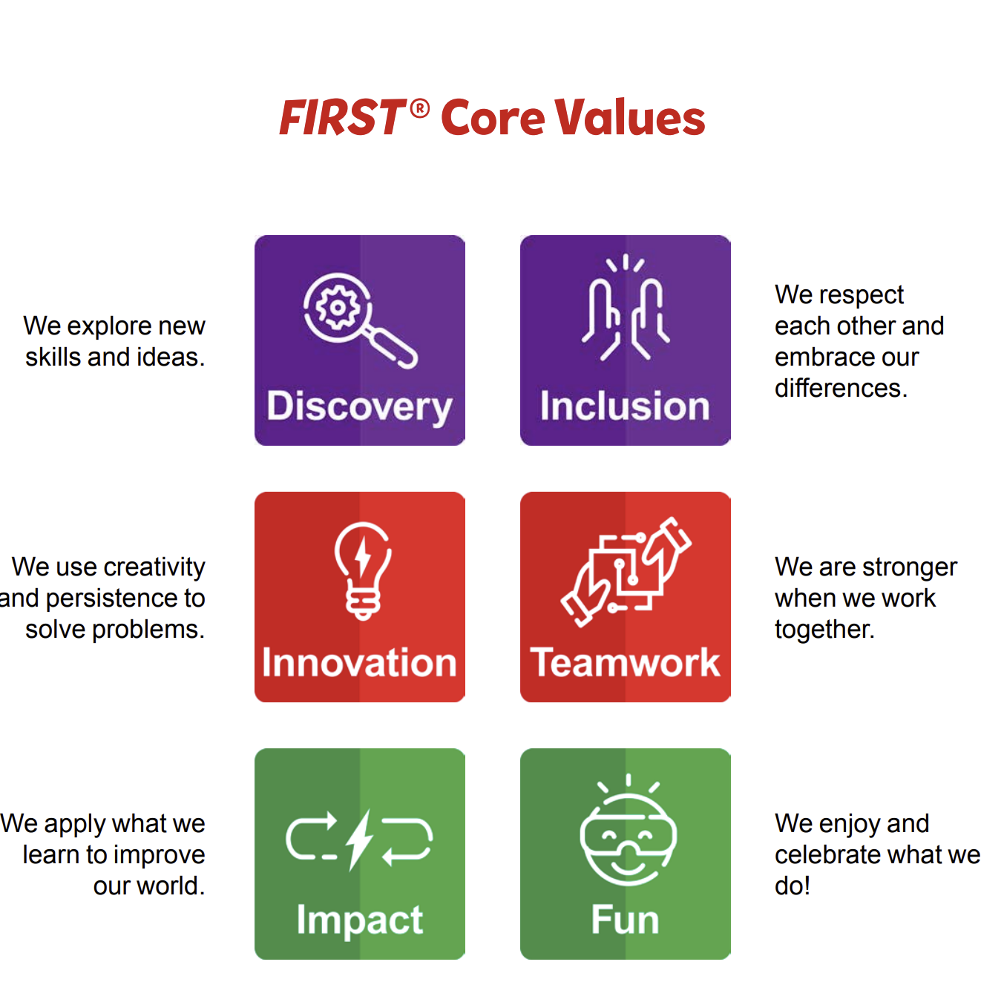
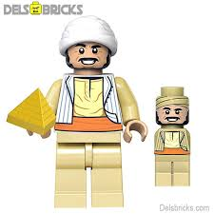
Core Values
Gracious Professionalism
Coopertition

Slide 8
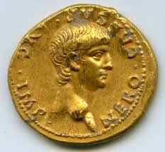
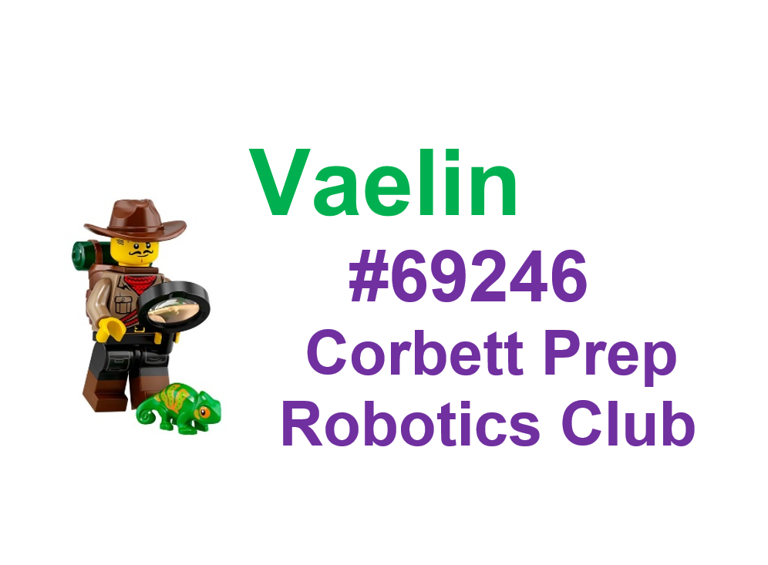


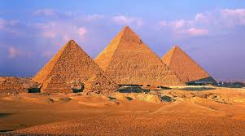
Name Tags, Core Values
Gold Coin – Build Robot
Arrowhead – Arm Attachment
Trowel – 3 Codes
Innovative Project Identified
Pyramids of Giza –
Completed Mission

Slide 9
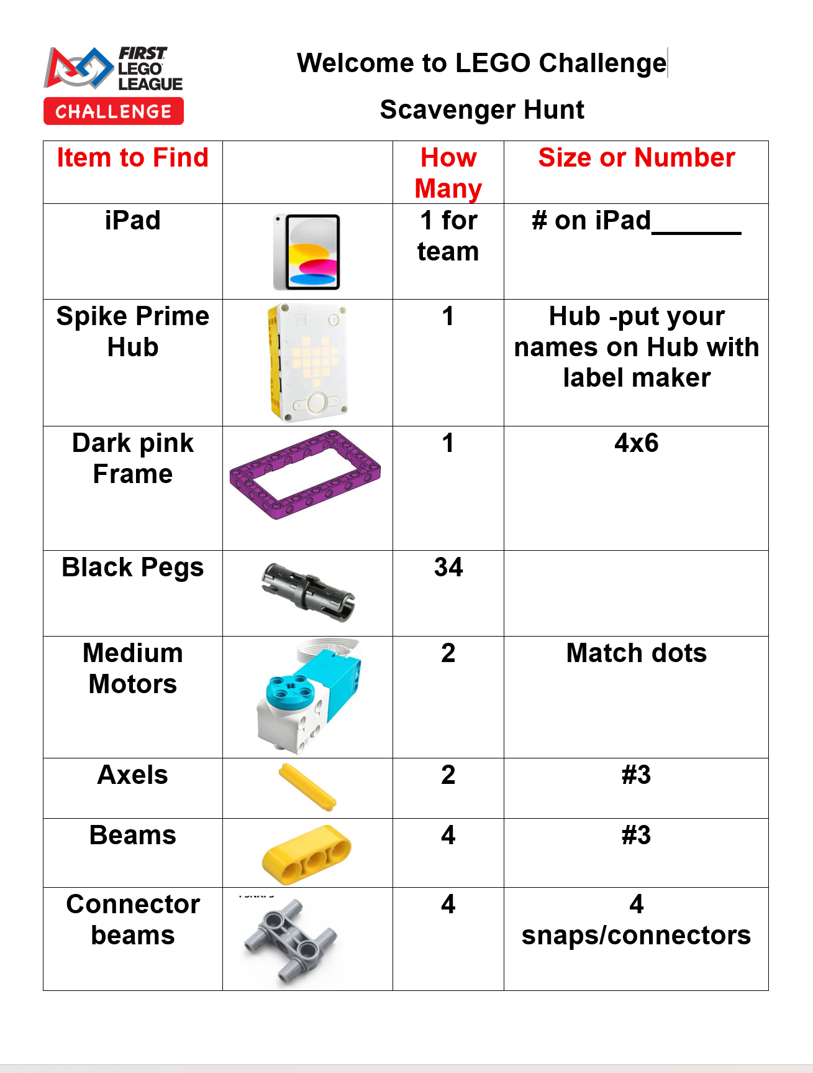
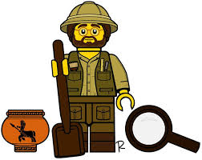
Scavenger Hunt
How to Find LEGOs in AppLab
2 Locations, sorting tray
Labels on drawers
Exact pieces for robot build
14 Partners, 2 per robot
Teamwork, Fun, Discovery

Slide 10
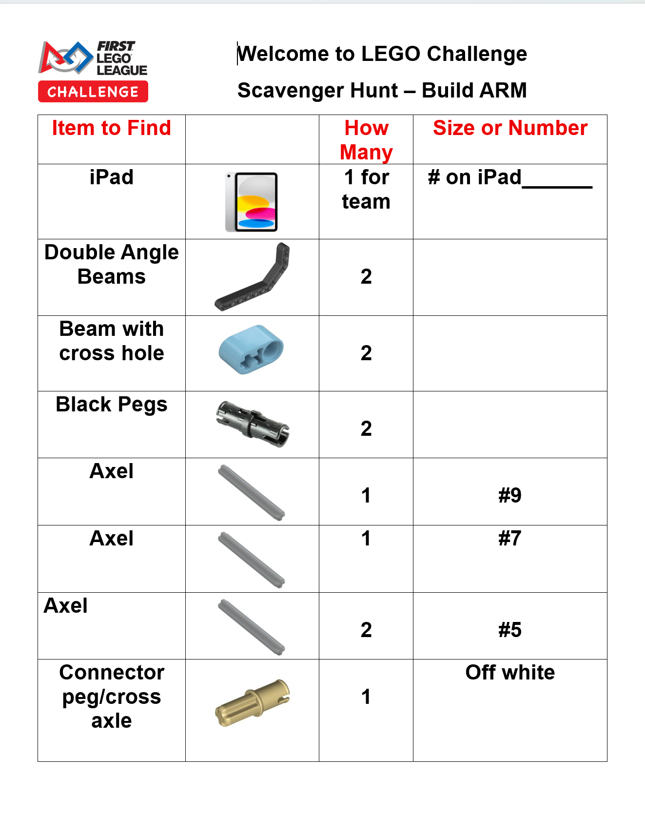
Arm Attachment Instructions

Slide 11
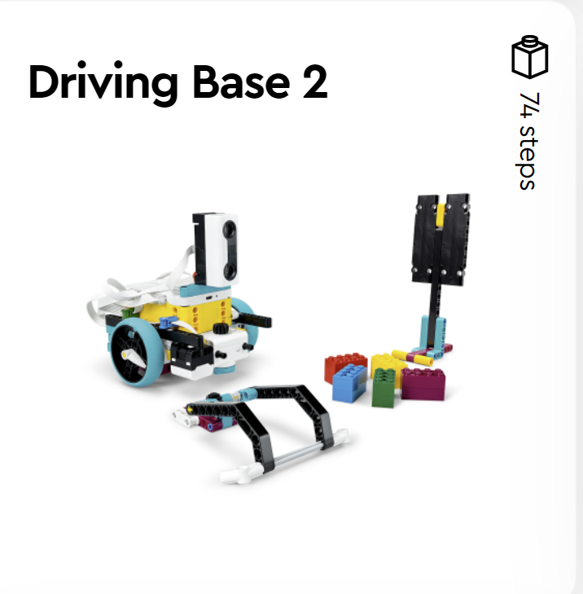
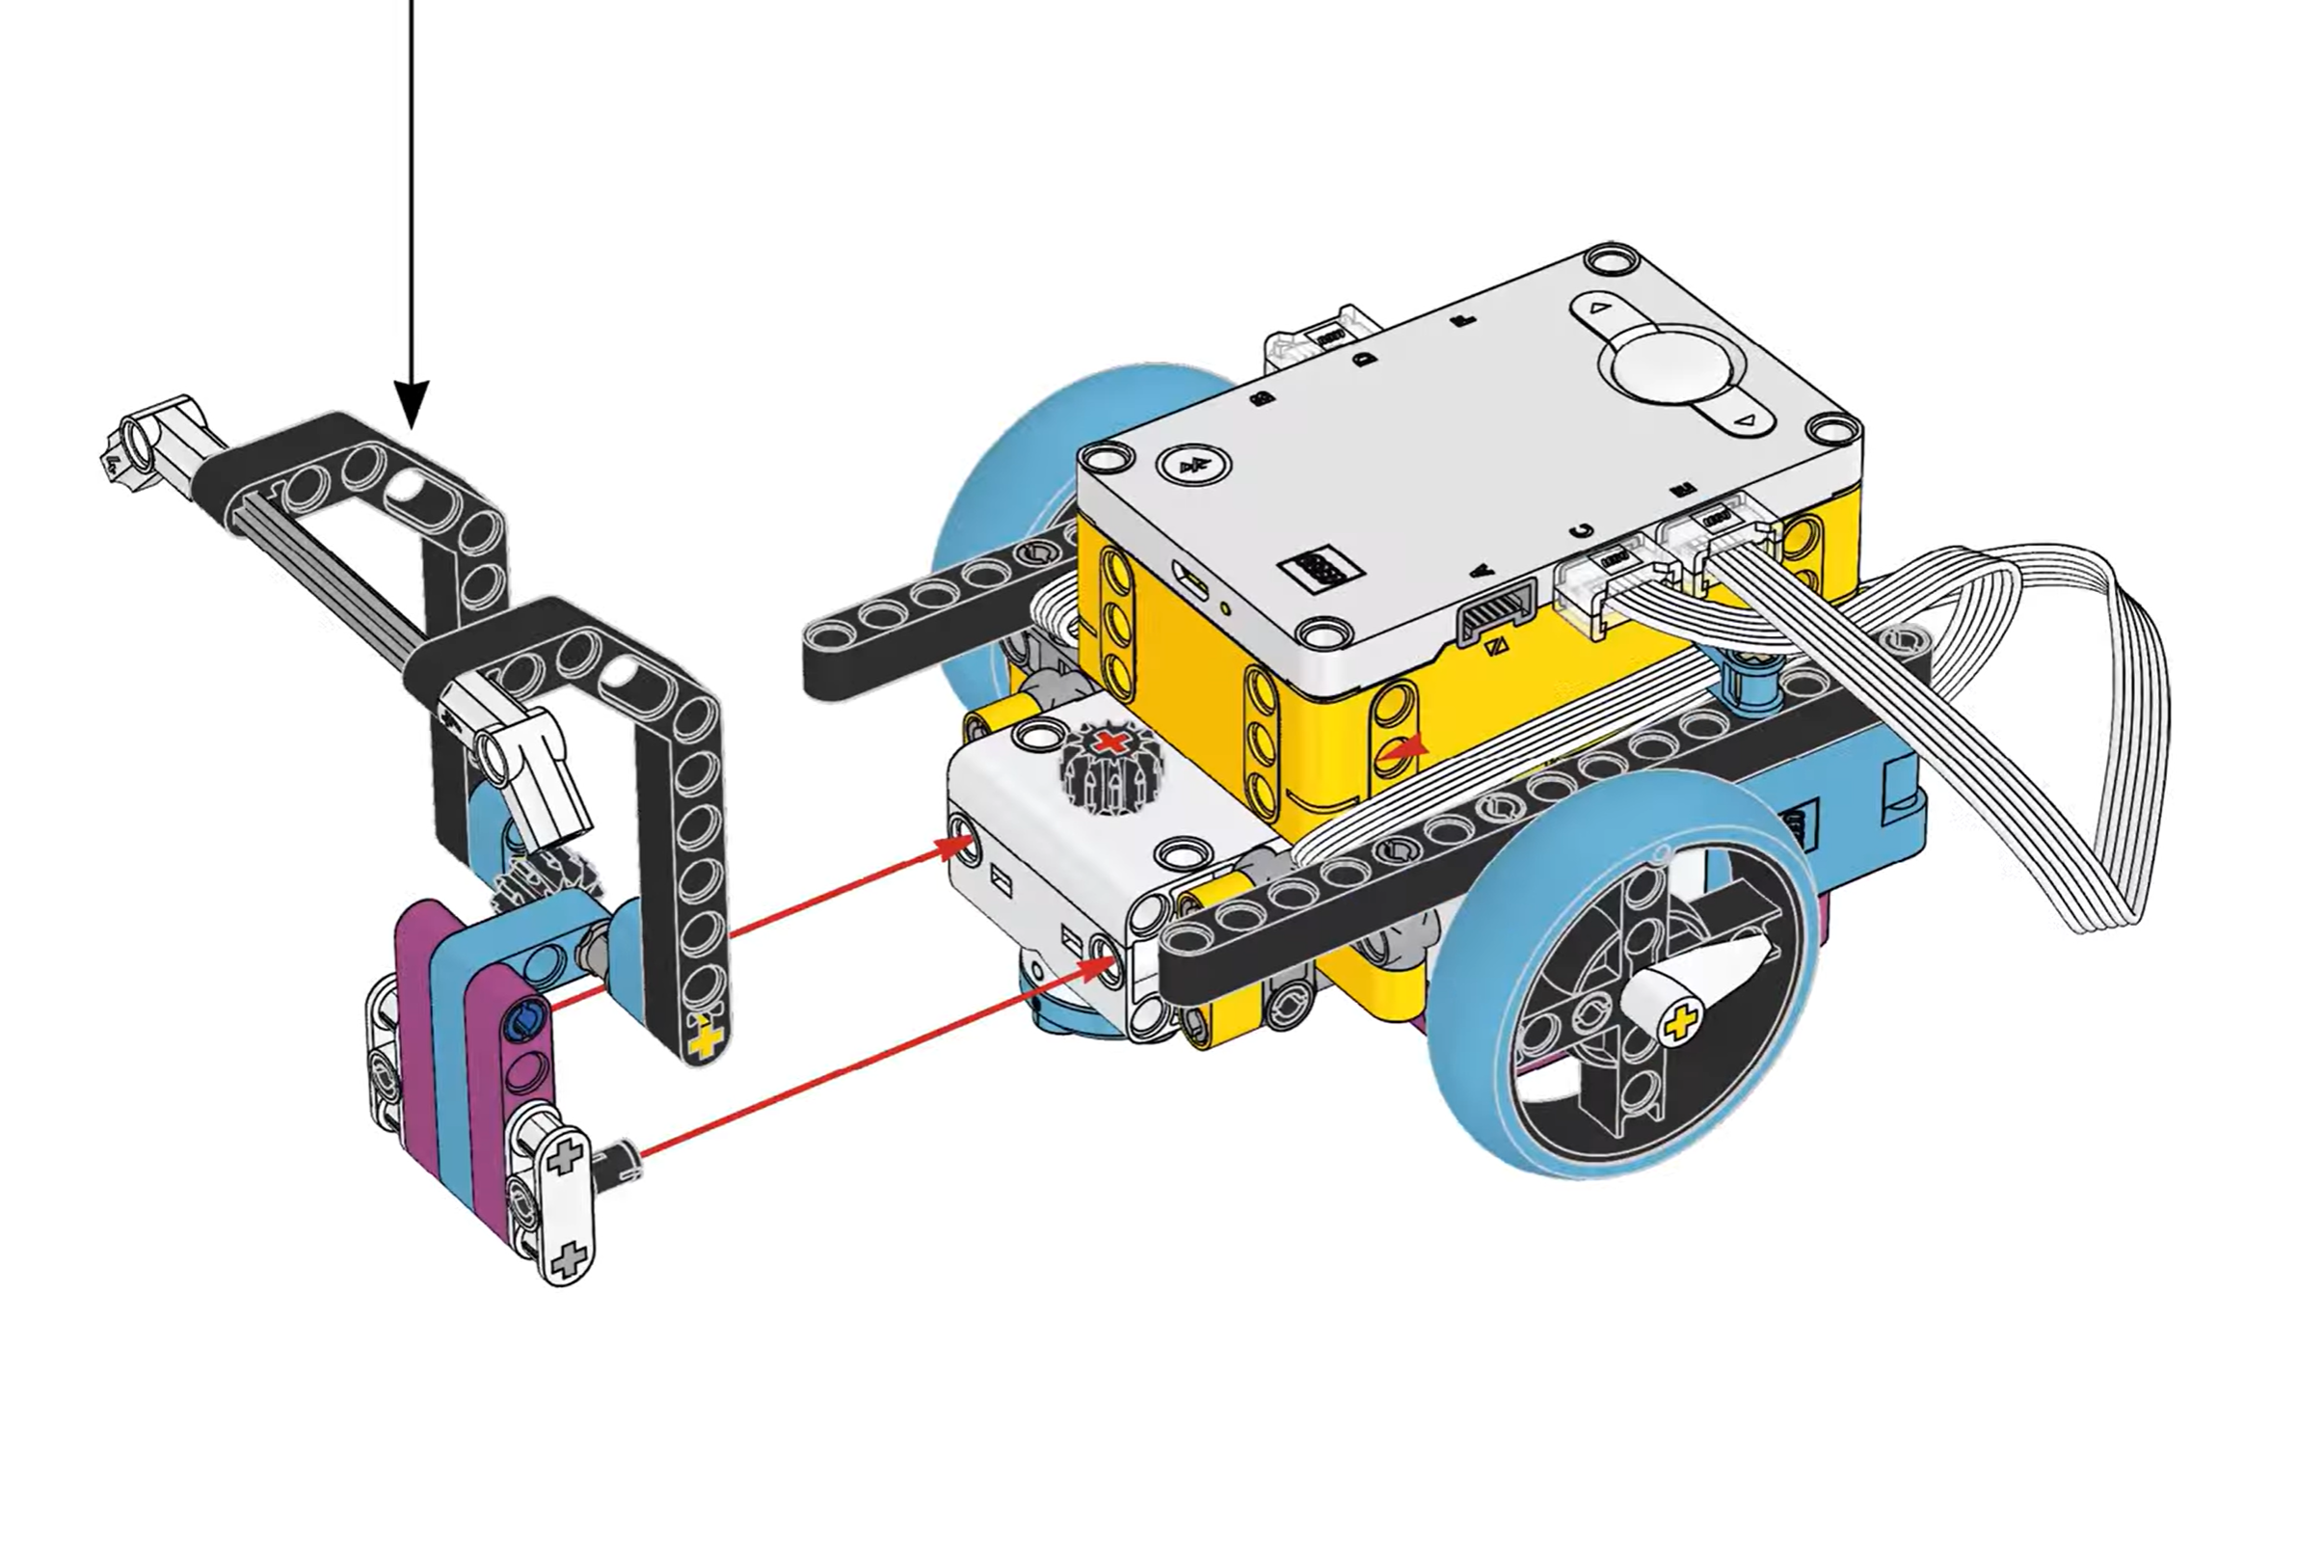
Build arm for robot

Slide 12
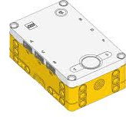
Partners build robot and arm attachments
Bluetooth Button
Bring robot
Arm
iPad
B
D
F
Navigation Arrows
E
Start Button
Navigation Arrows

Slide 13
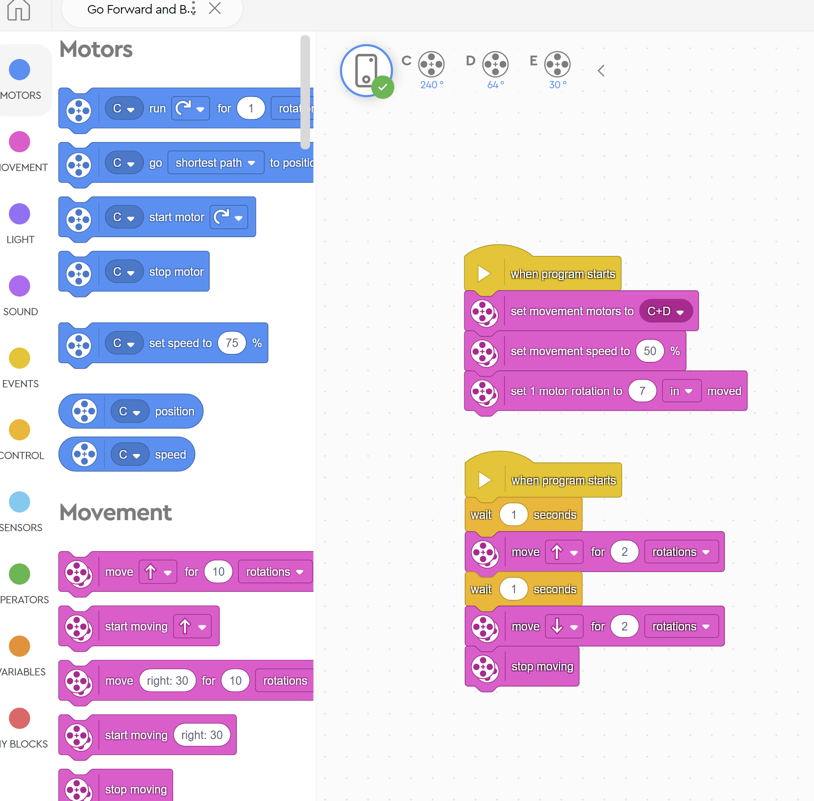
Challenge Team
Forward and Back

Slide 14
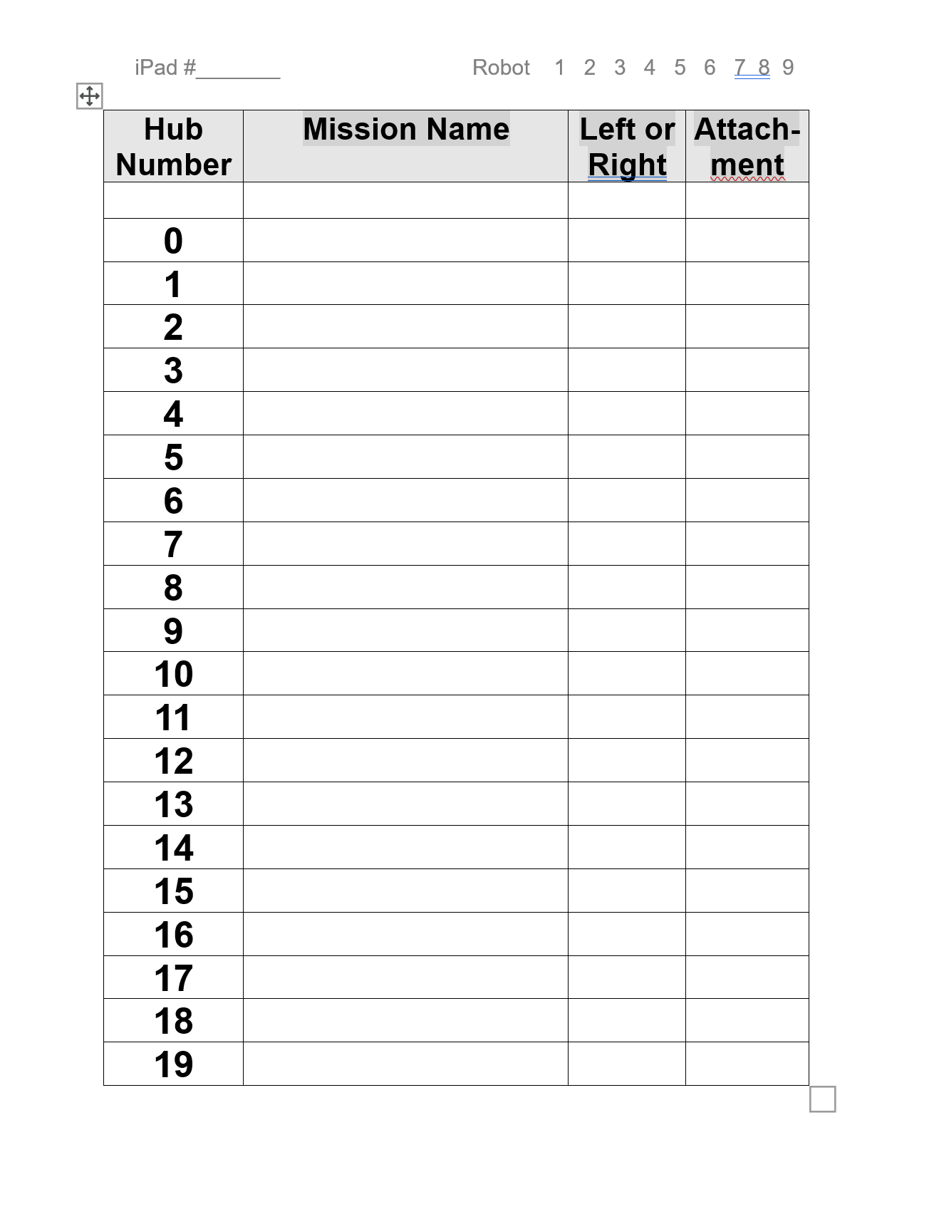
1 piece of paper
Allowed at Mission
Board

Slide 15
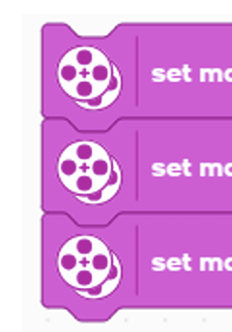
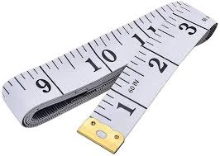
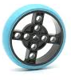
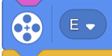
2 motors
7 inch wheel
1 motor
E Port
1 Rotation =
7 inches

Slide 16
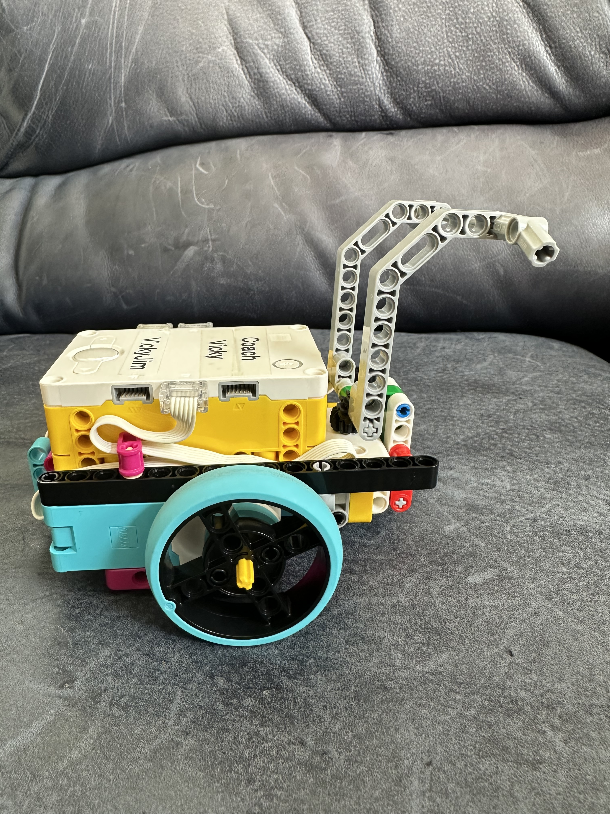
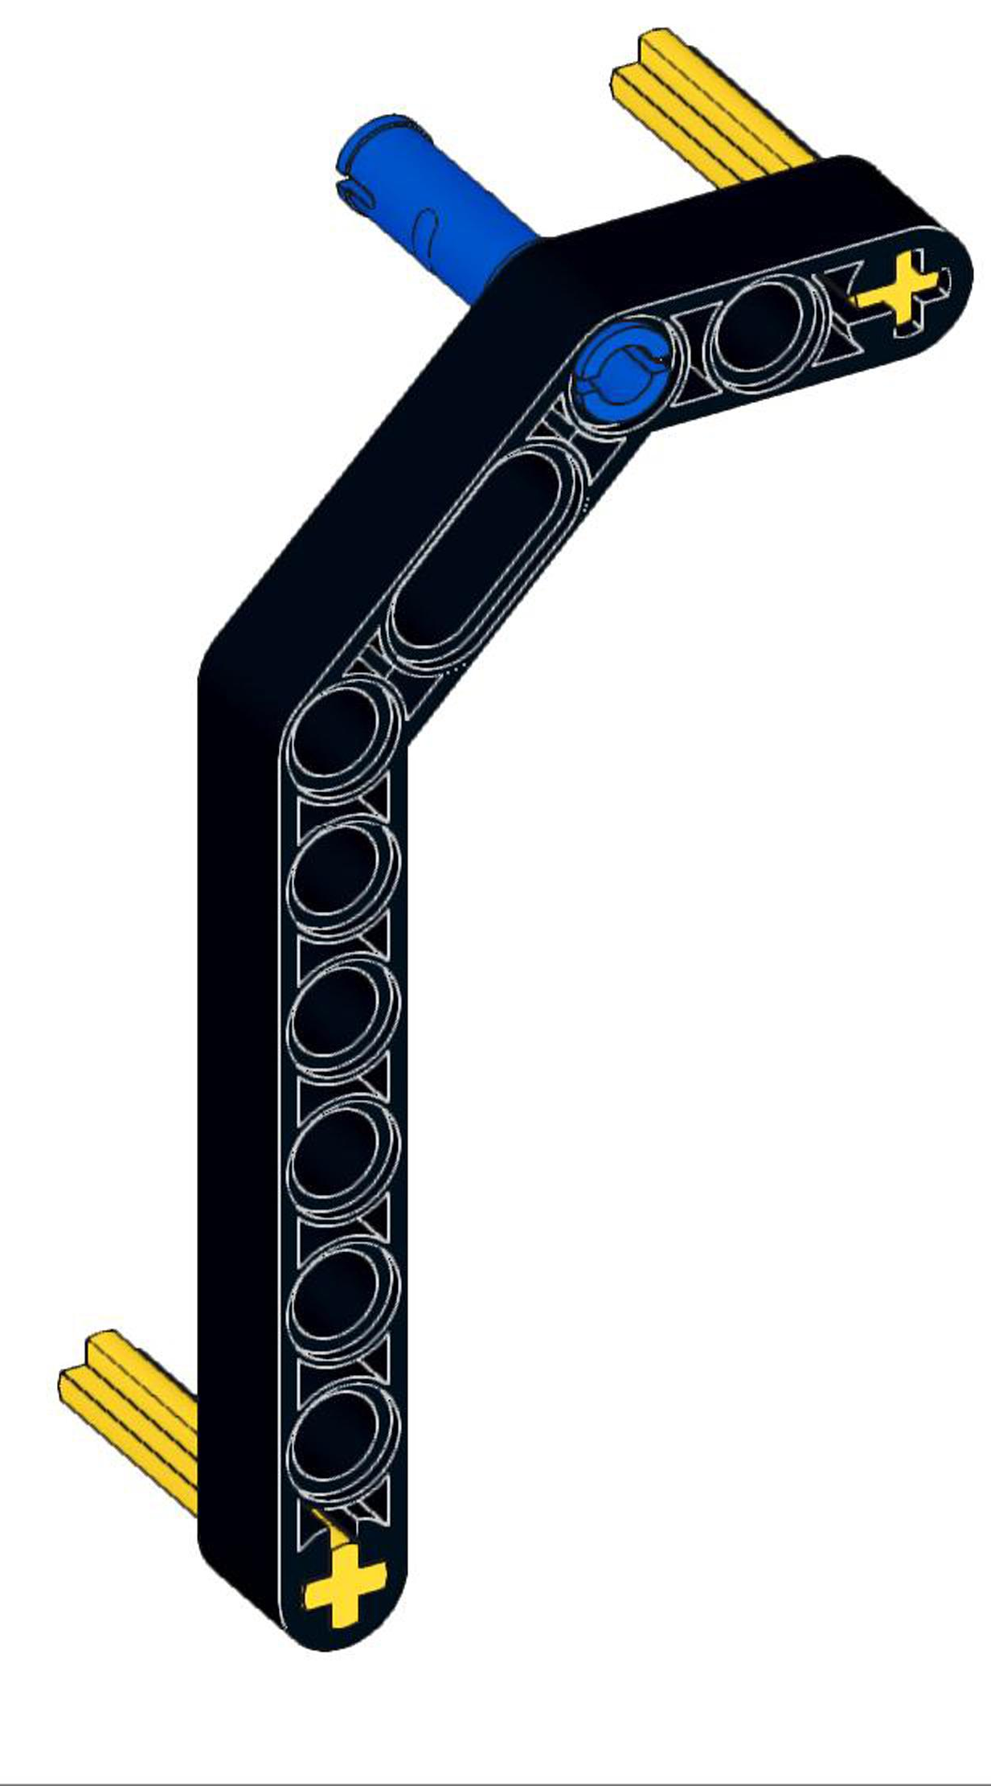
Can the arms go in a complete circle?
1
.5
1 rotation of Wheel = 7 inches

Slide 17
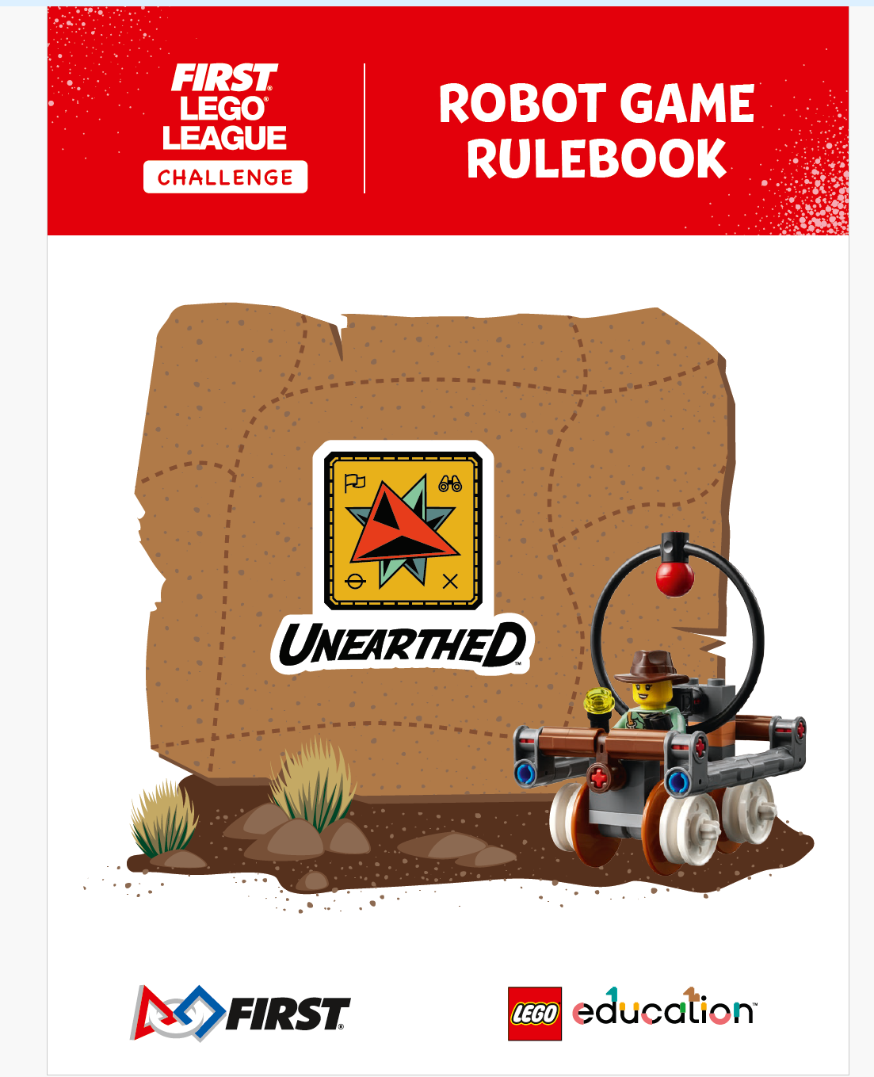
Mission Board and Game
15 Missions
2.5 minutes, 1 practice round, 3 rounds score counts
Video and Book to explain the rules
Challenge Updates
Video – Red on each mission model, video shows “hands” move models – only robot can touch the models outside launch area
Robot must be autonomous, no iPad allowed at table
Attachments and one piece of paper

Slide 18
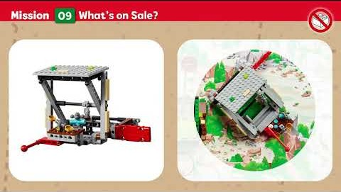

Slide 19
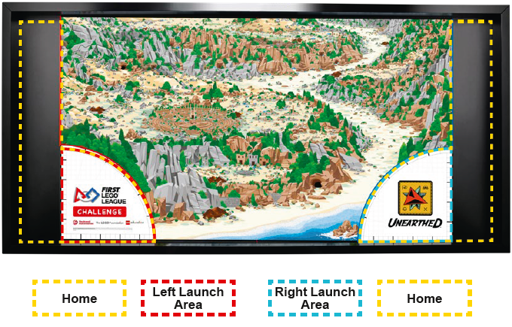

Slide 20
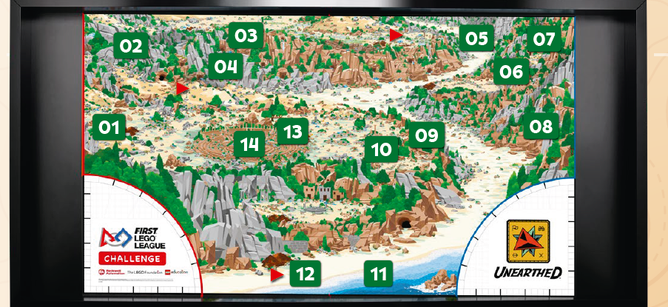

Slide 21
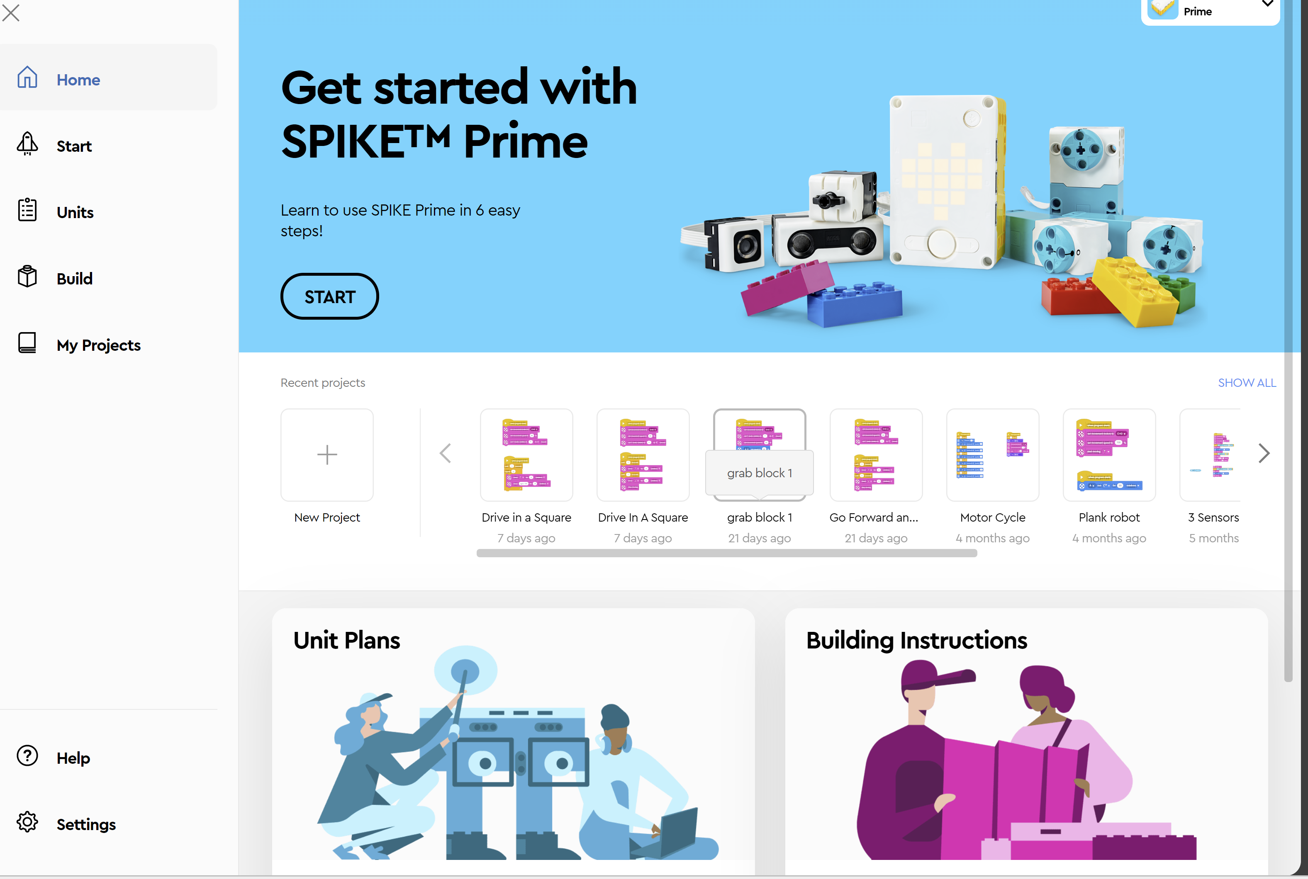
To Code
A new project
Select
New Project

Slide 22
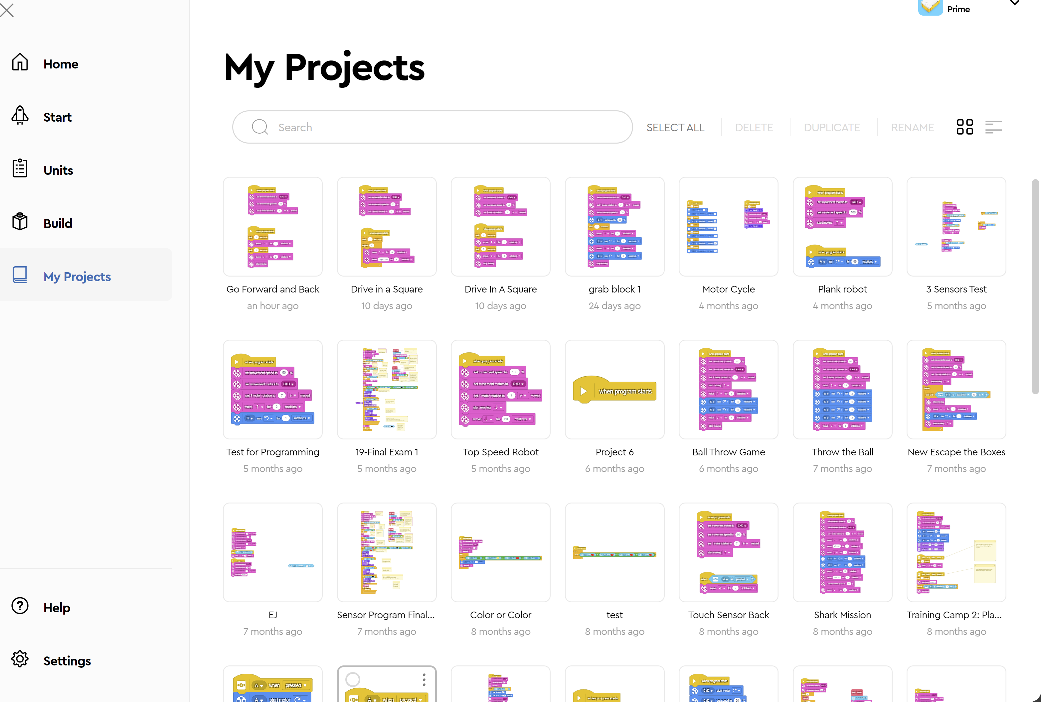

Slide 23
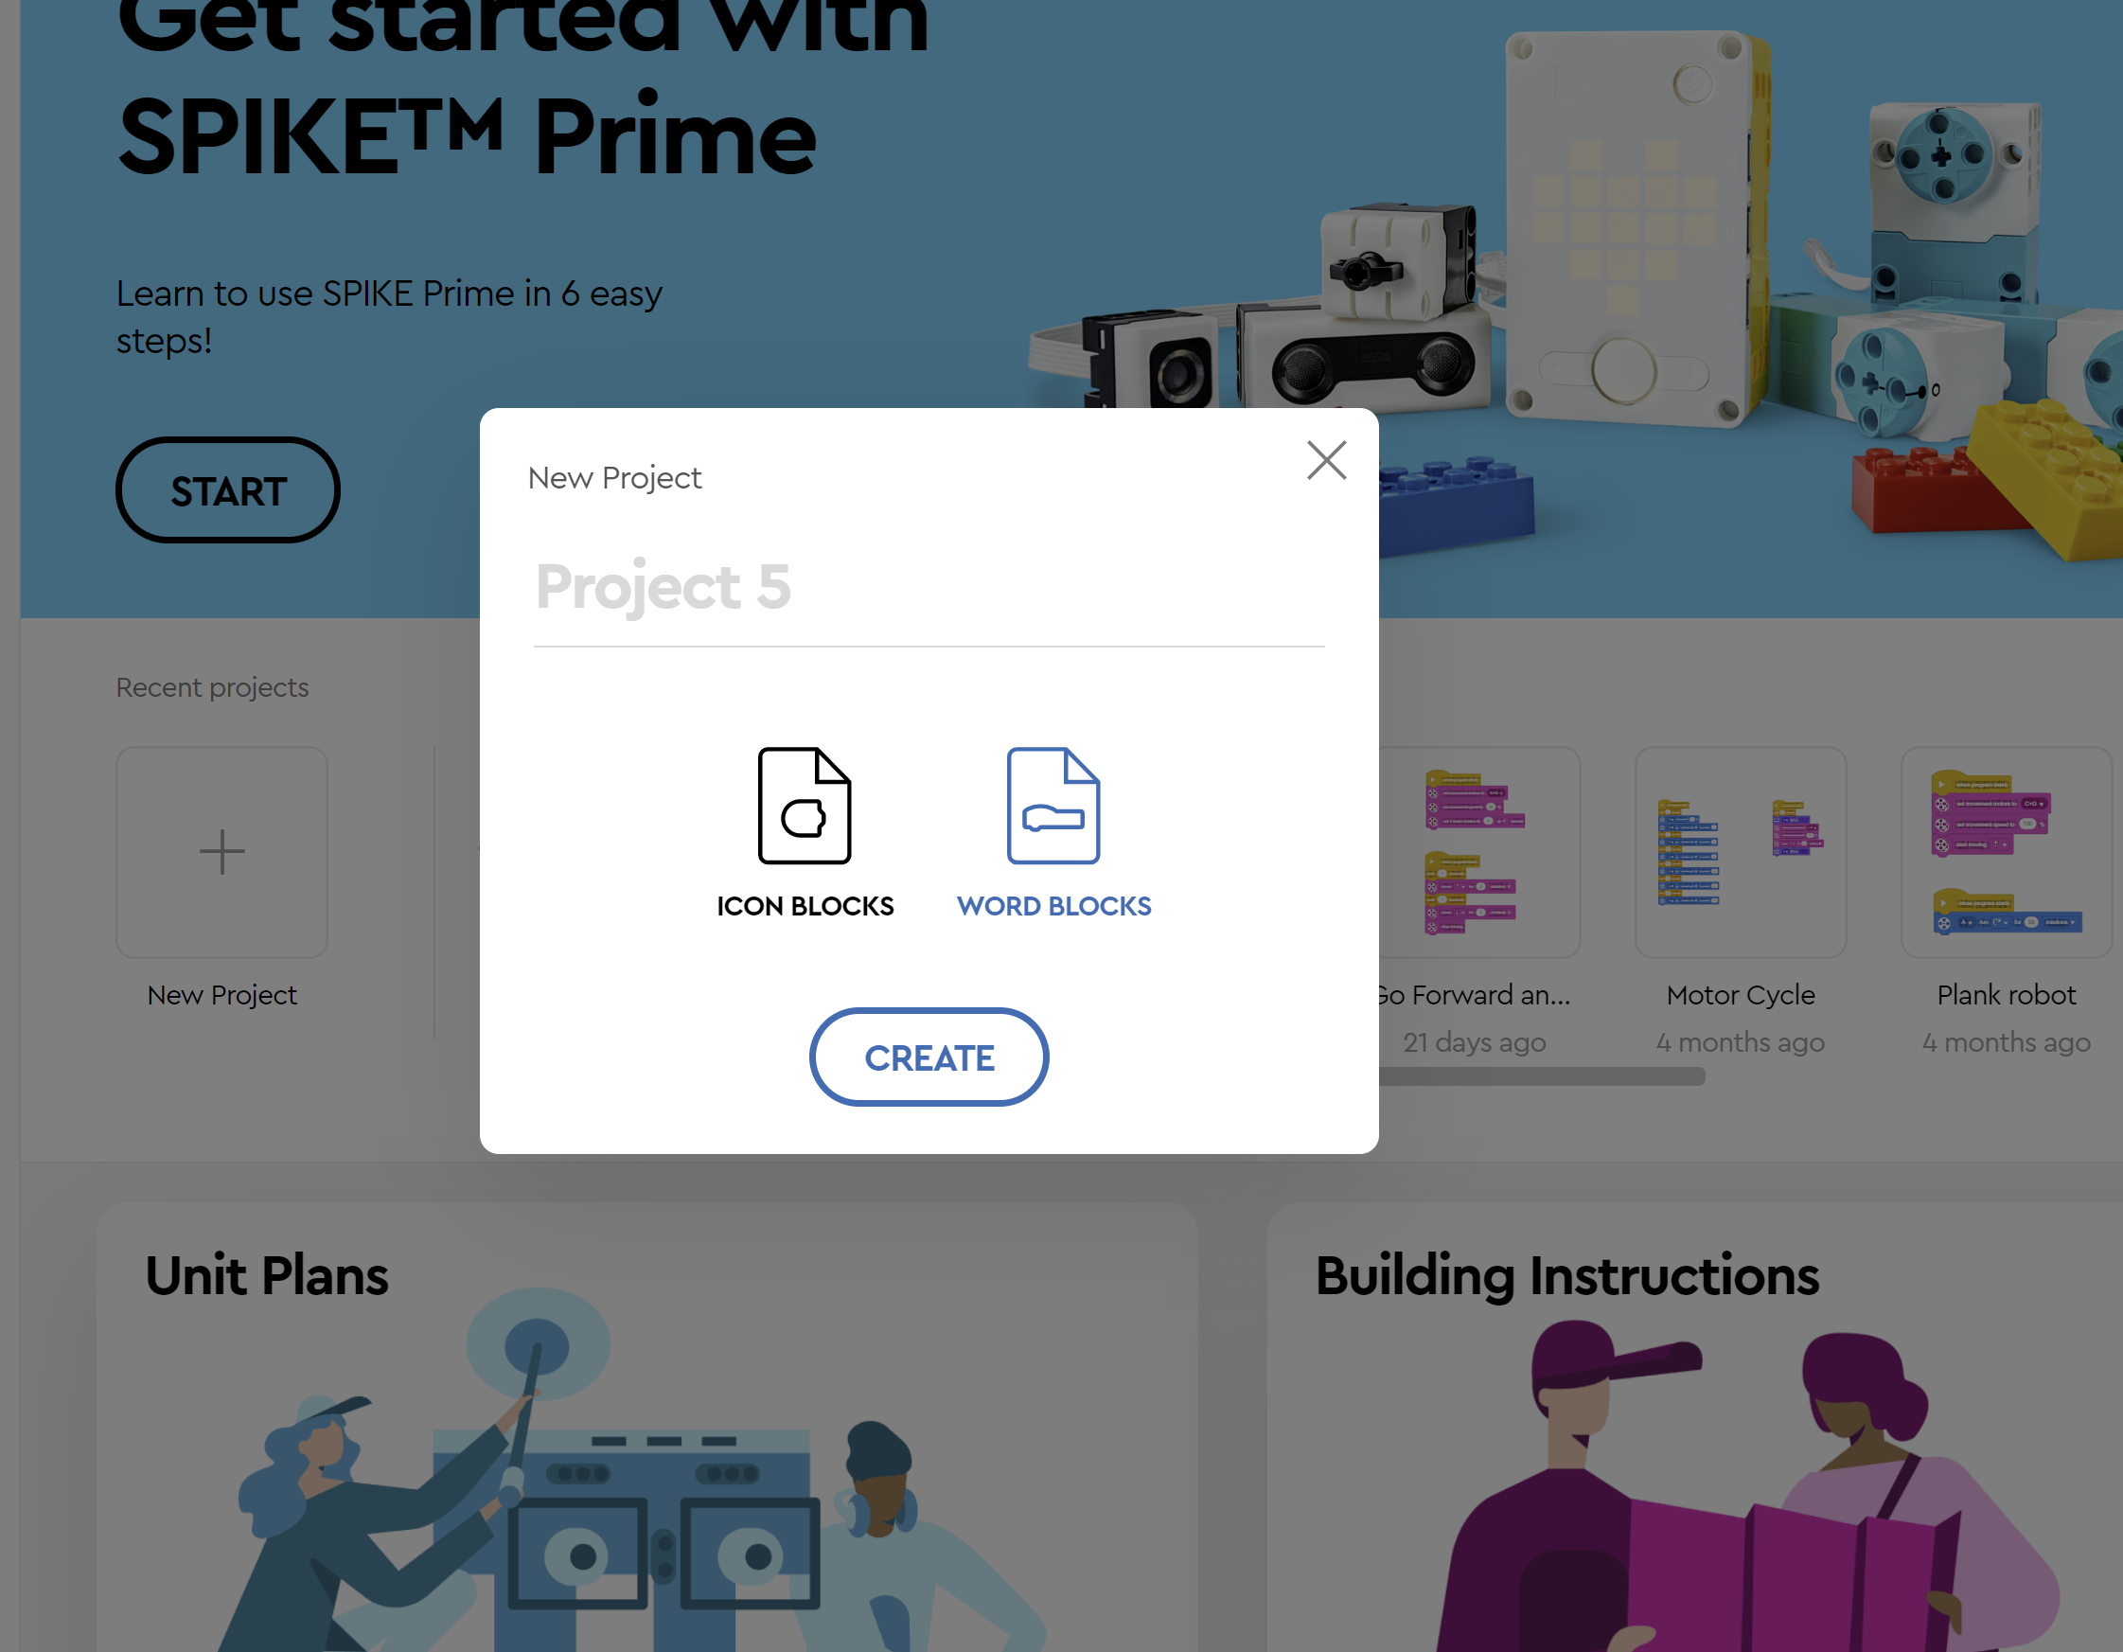
Name the
Project
(where it says
Project 5)
Describe
Project -
ForwardBack
Select WORD
Blocks
Create

Slide 24
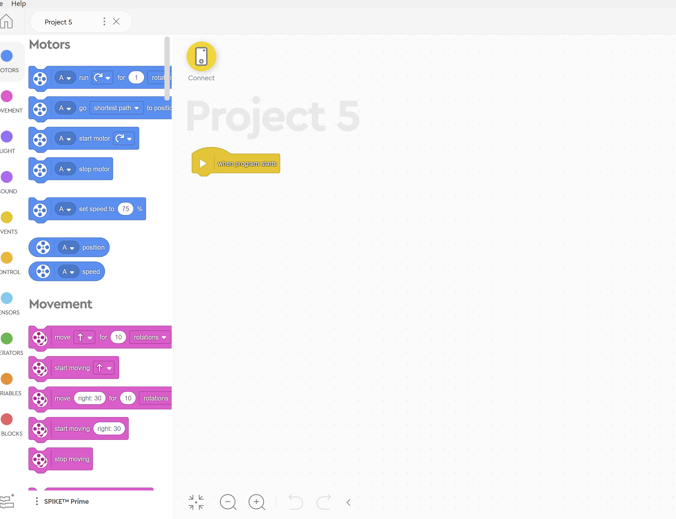
Press Start button
Robot - green
Press Bluetooth
Button on robot
Flashing Blue

Slide 25
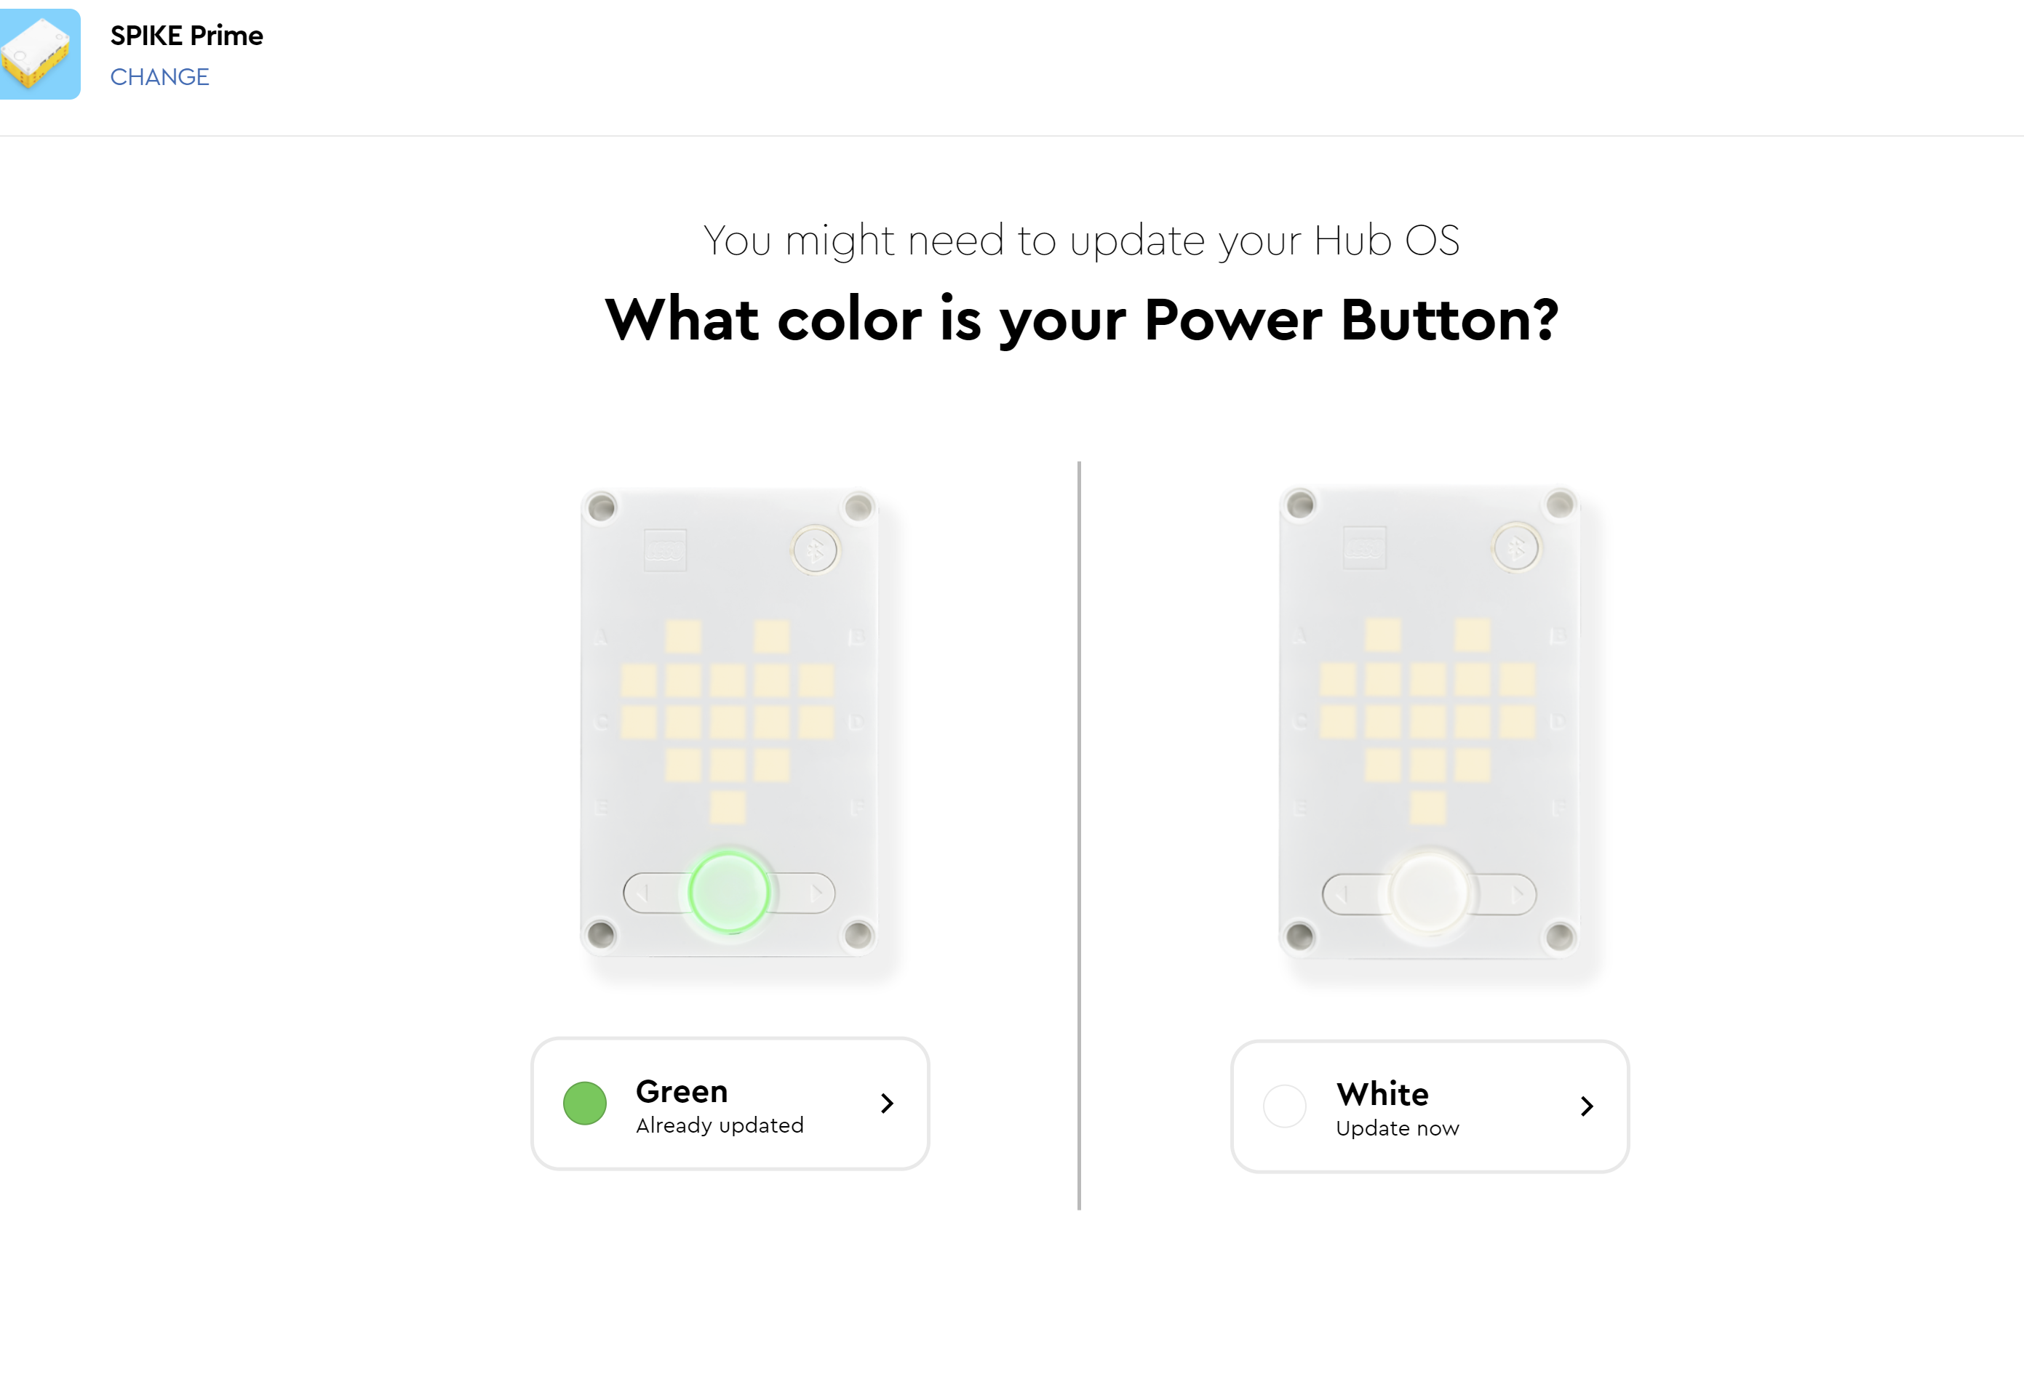

Slide 26
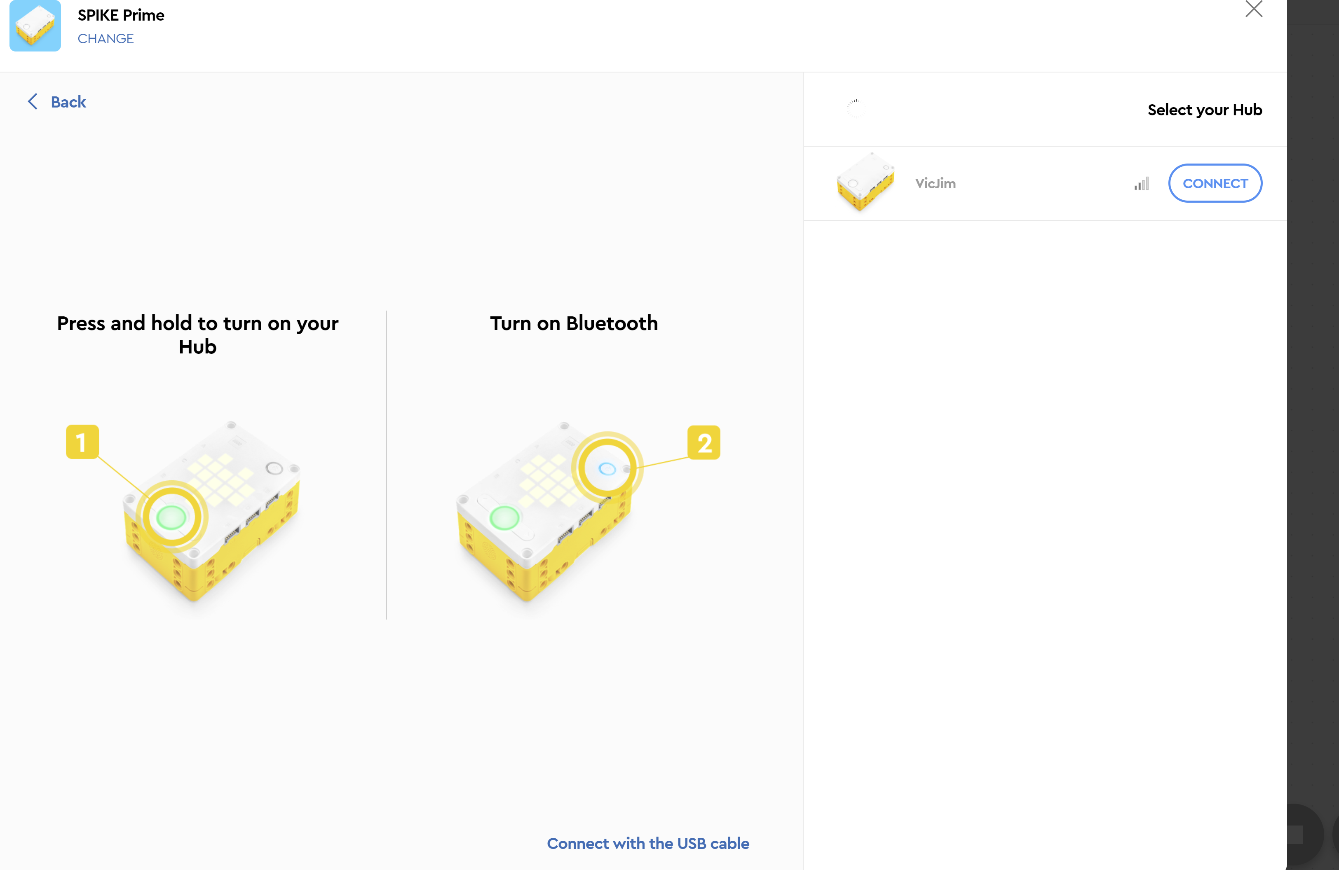

Slide 27
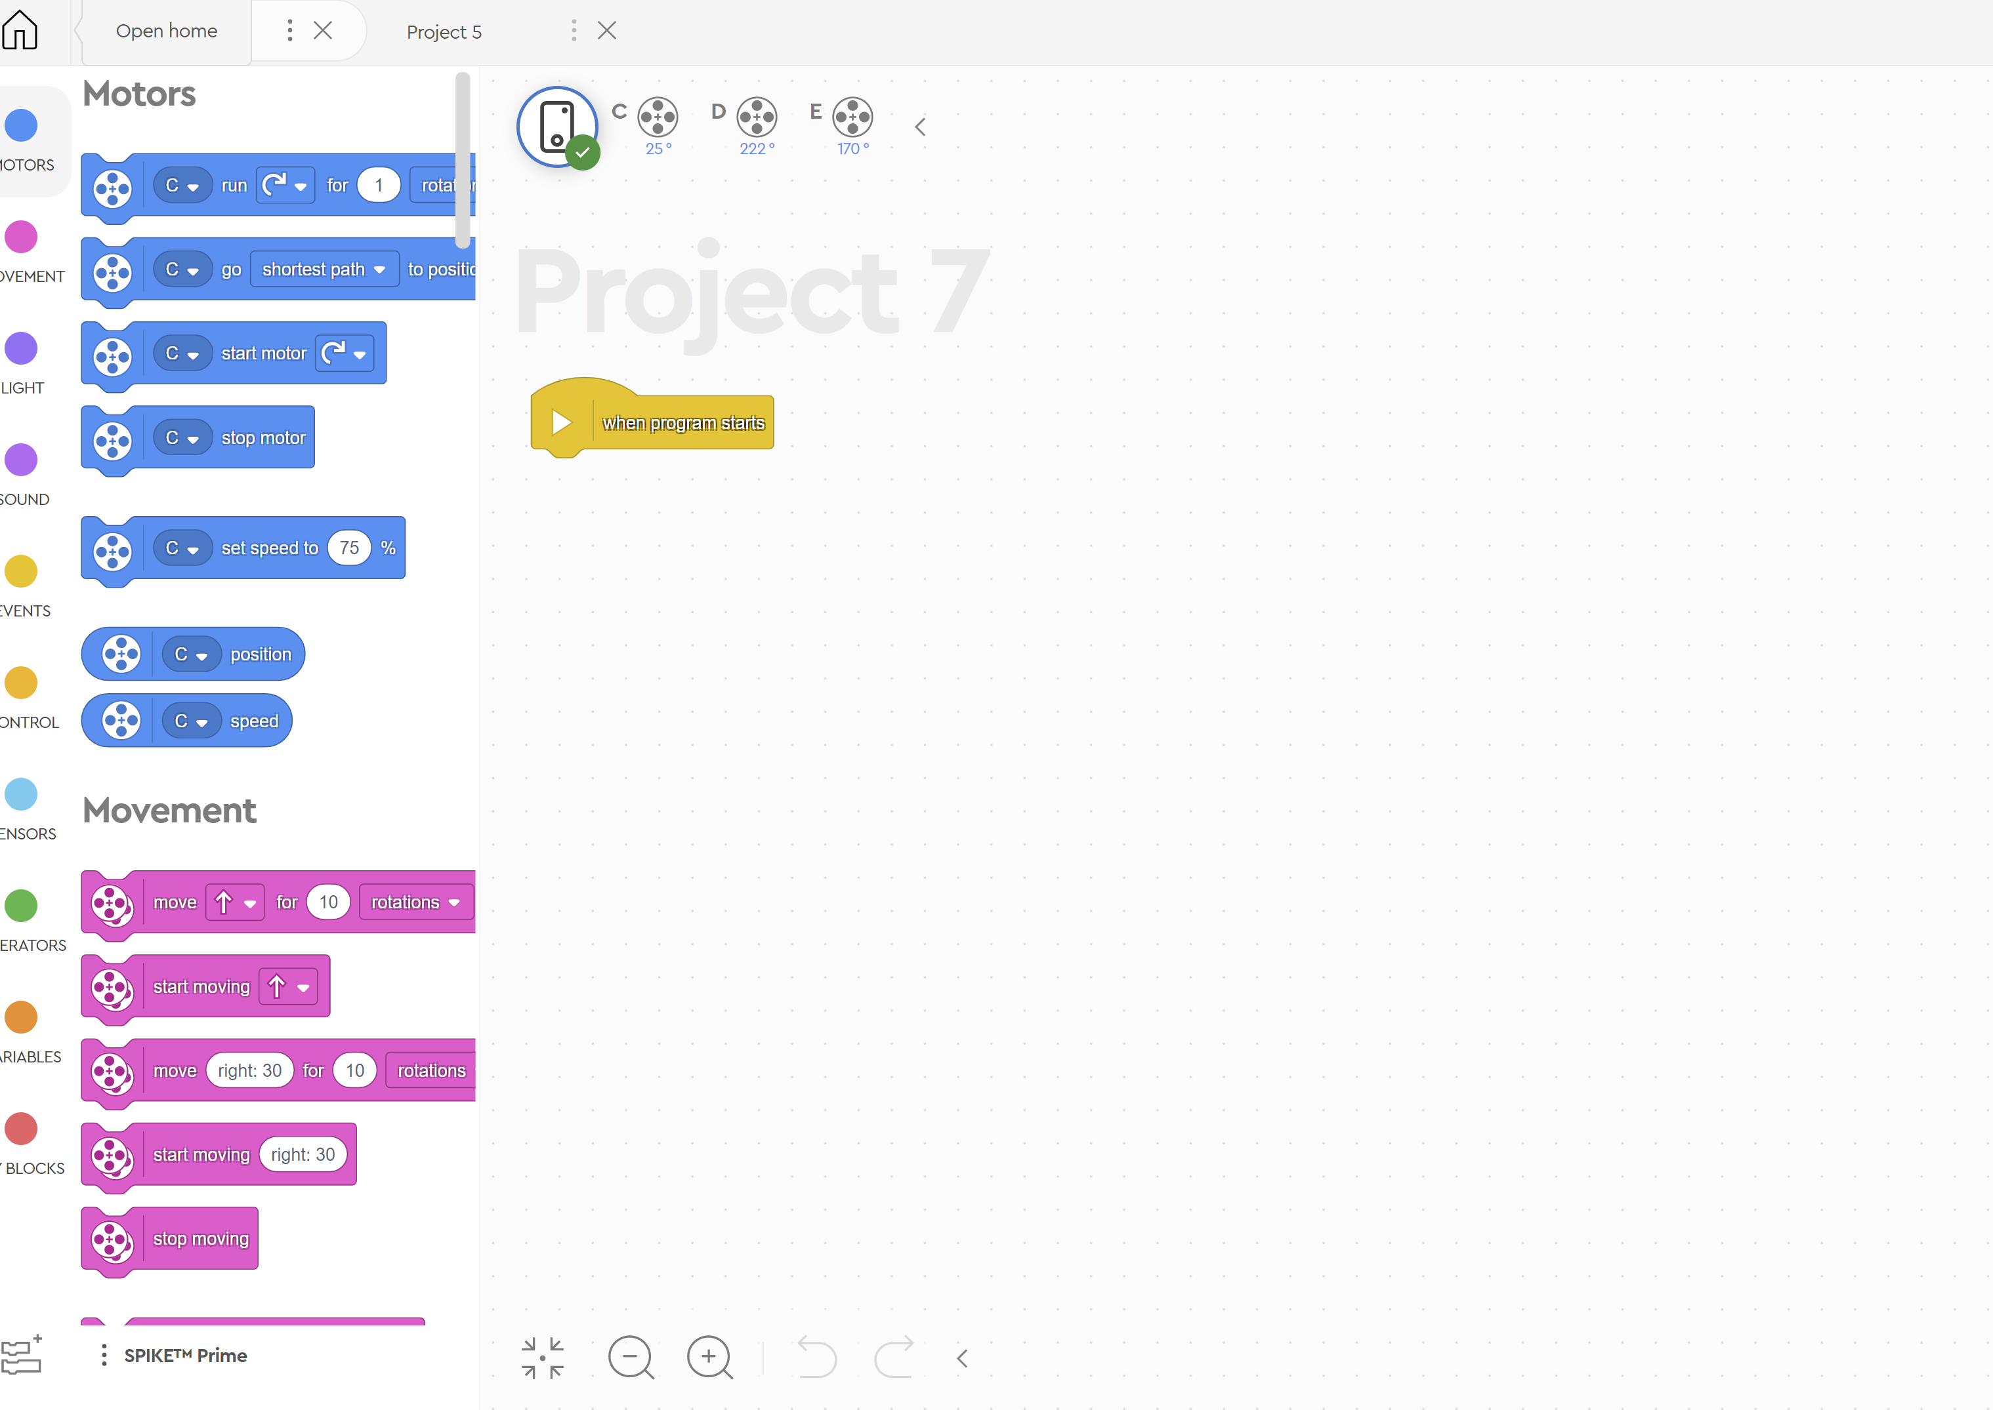

Slide 28
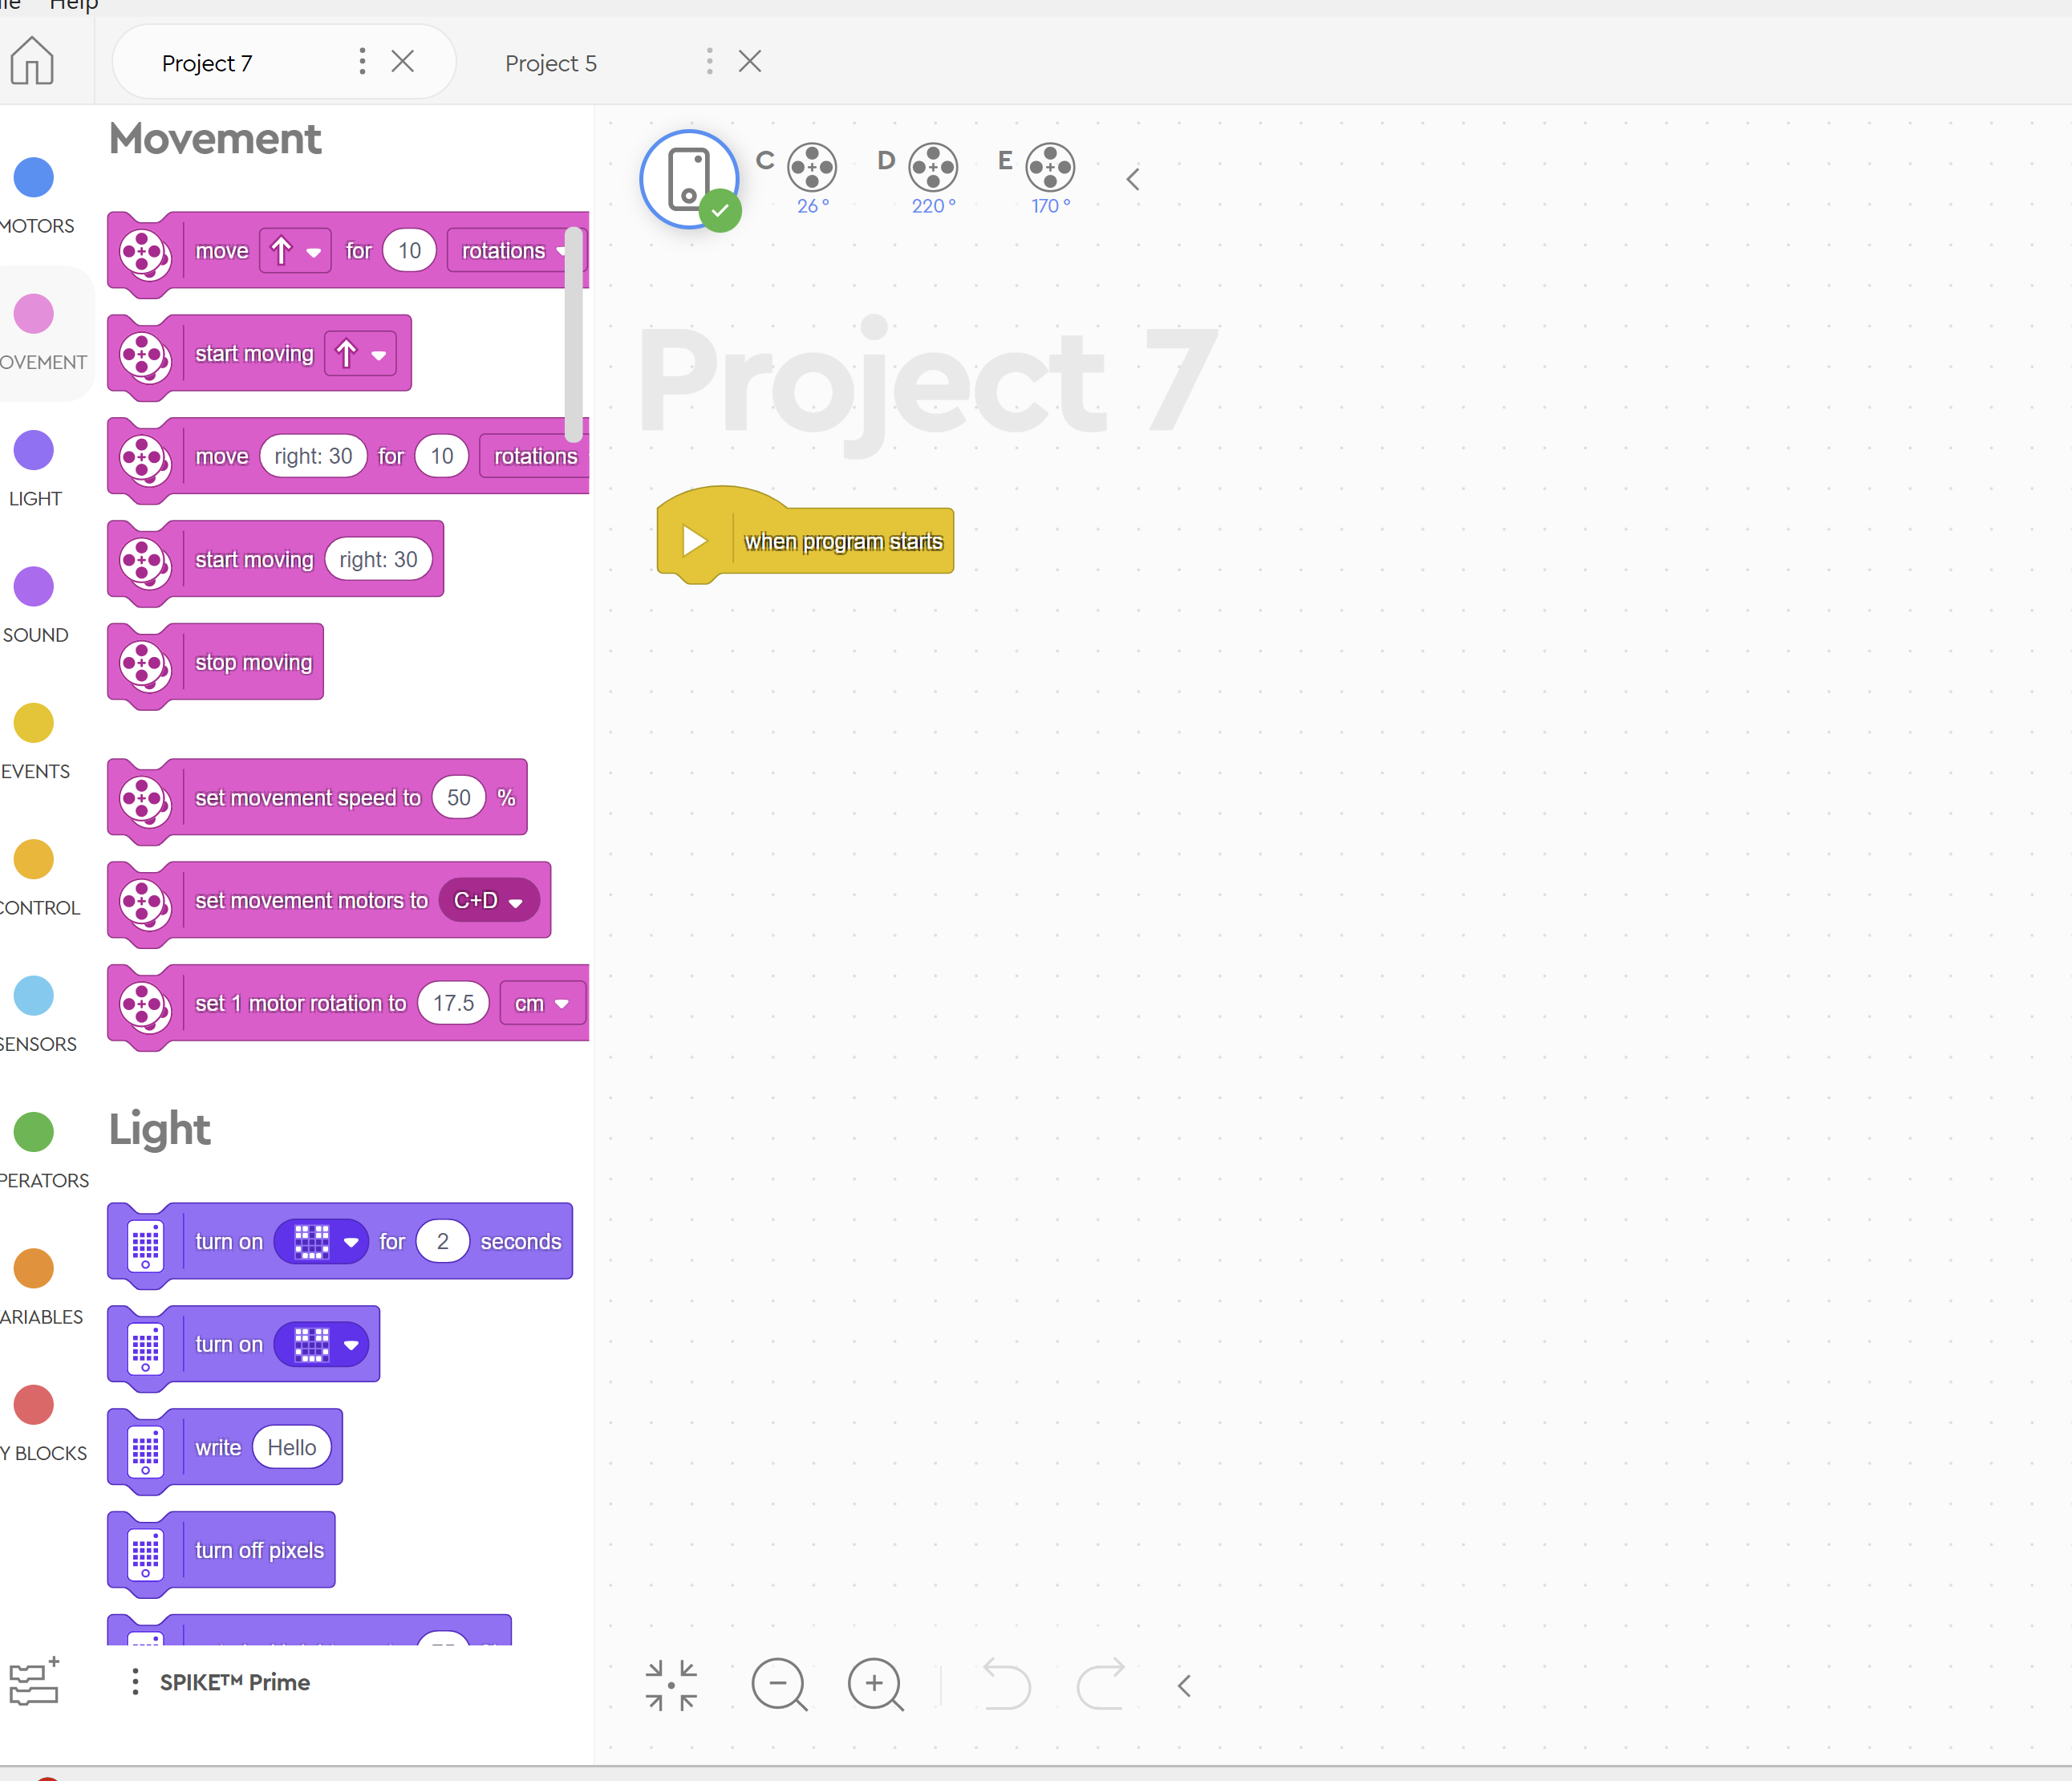

Slide 30
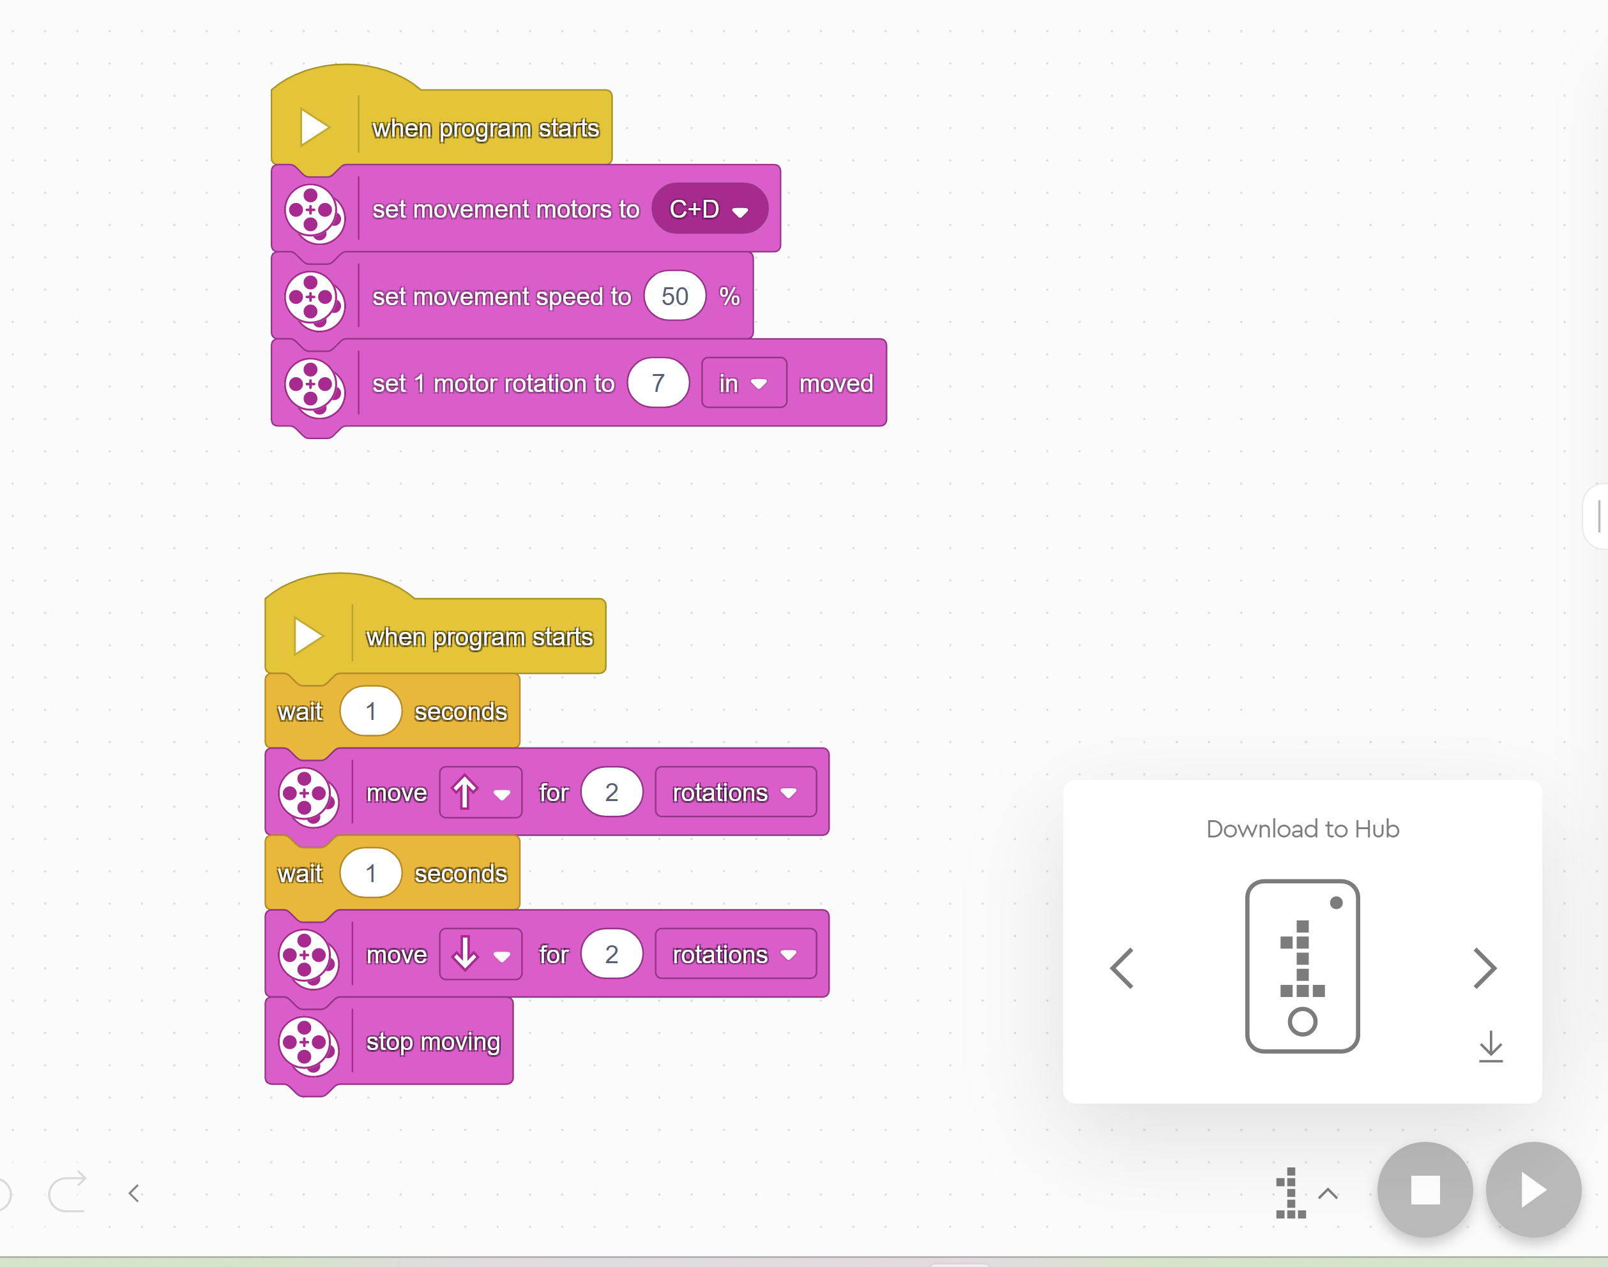

Slide 31
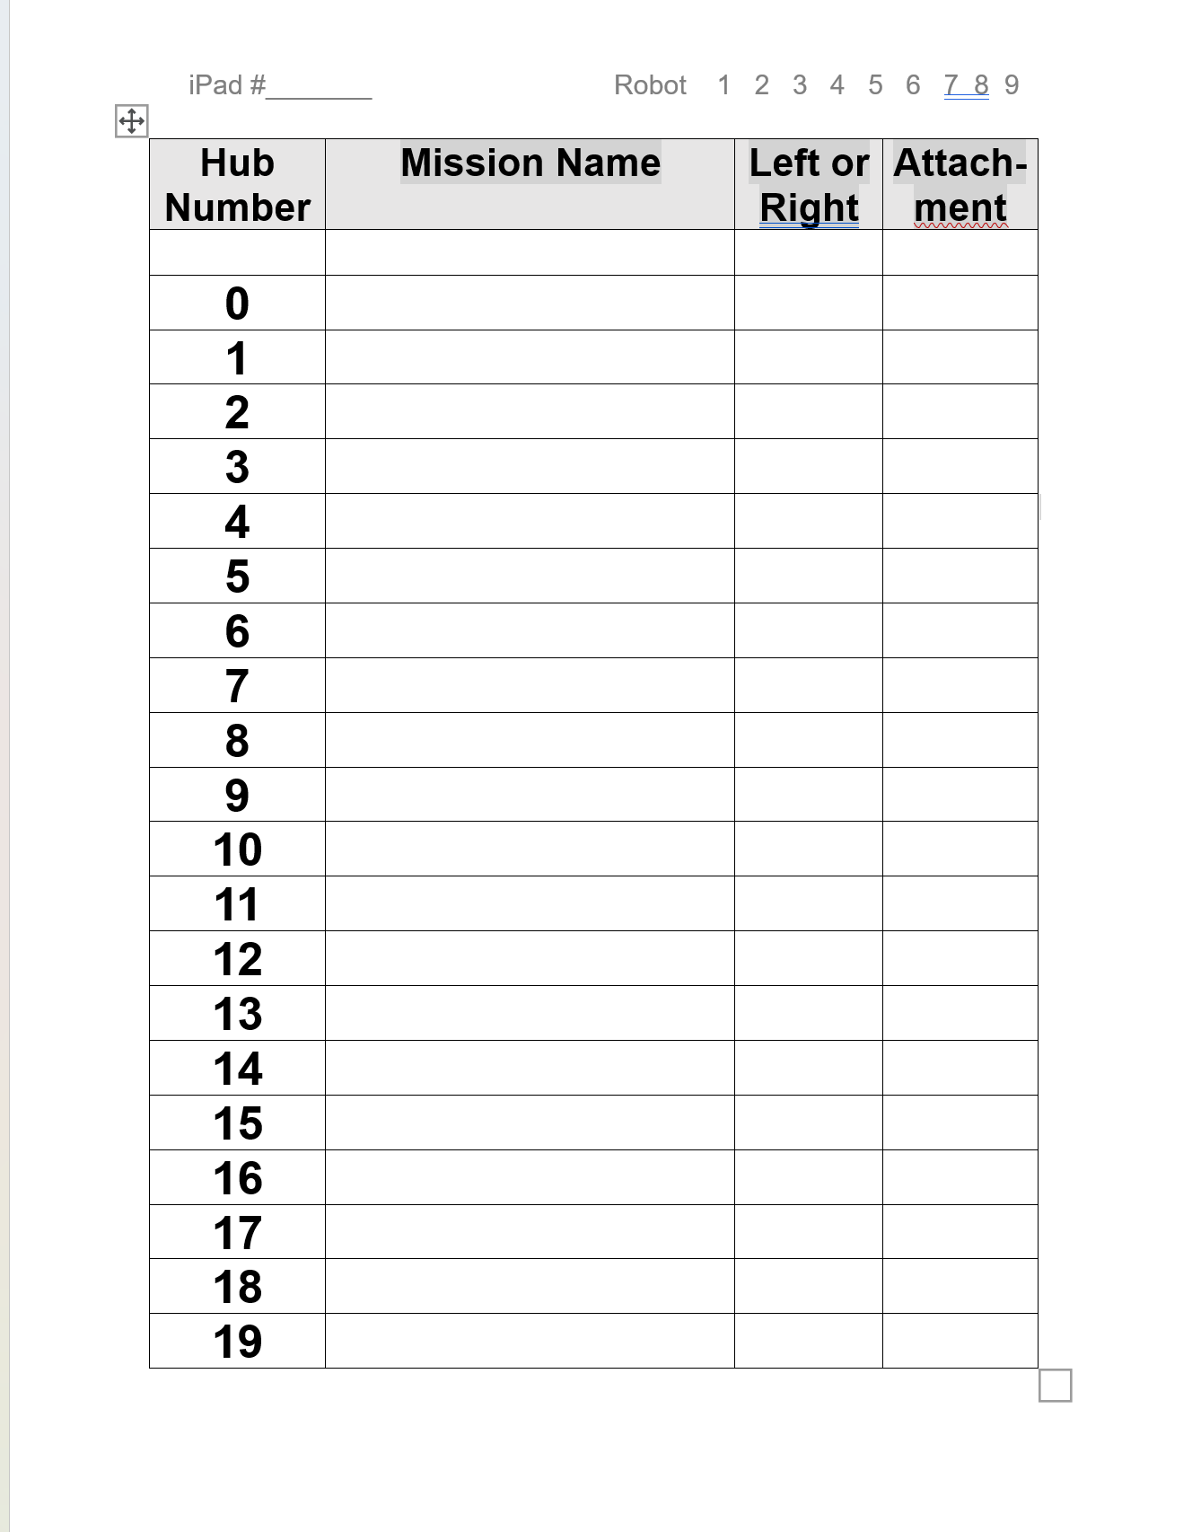
Vicky laptop
VicJim
Forward Back

Slide 33
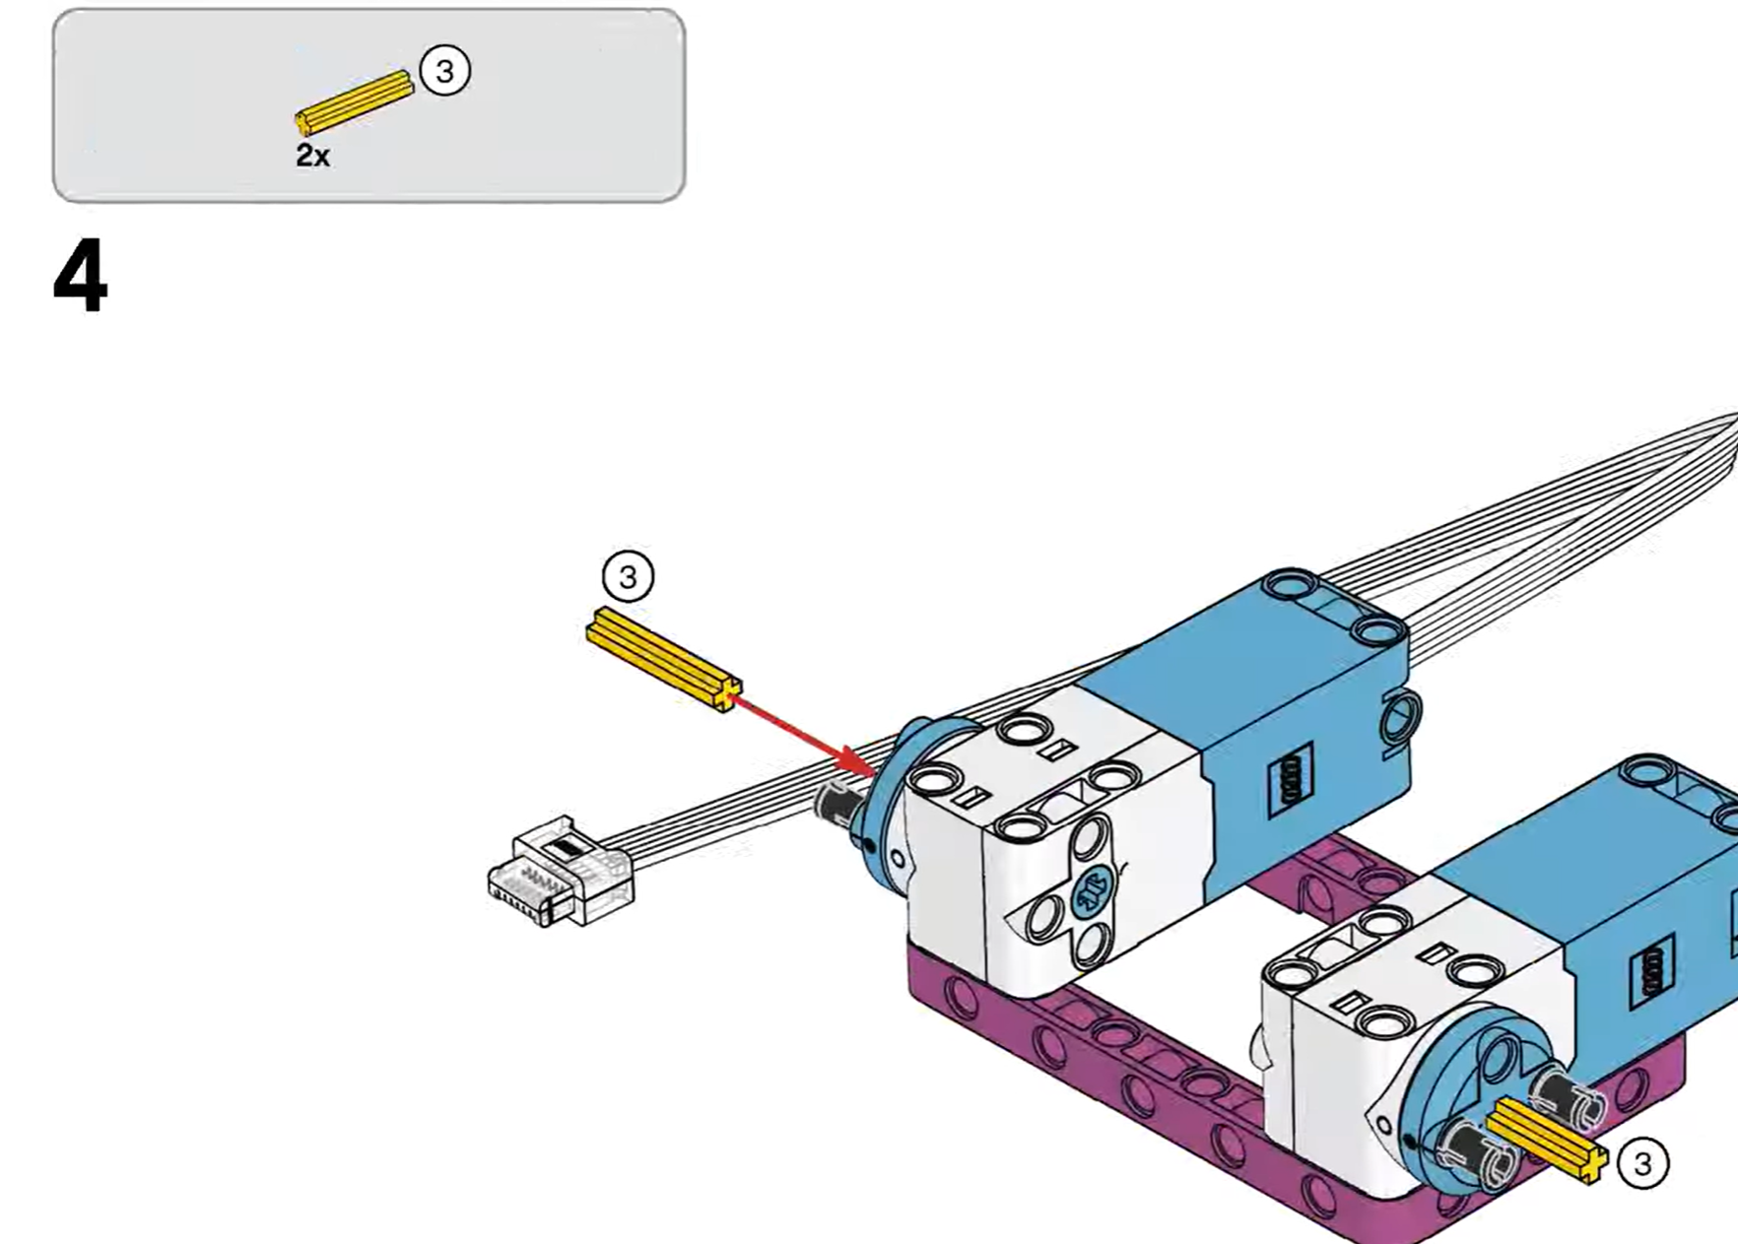
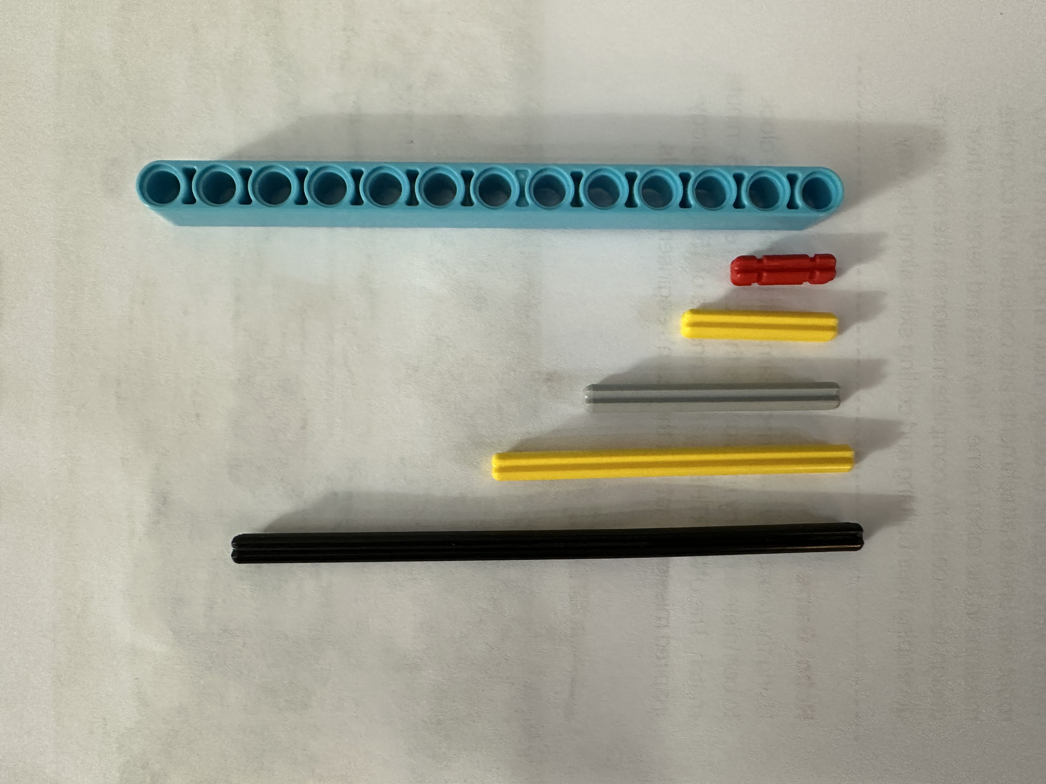
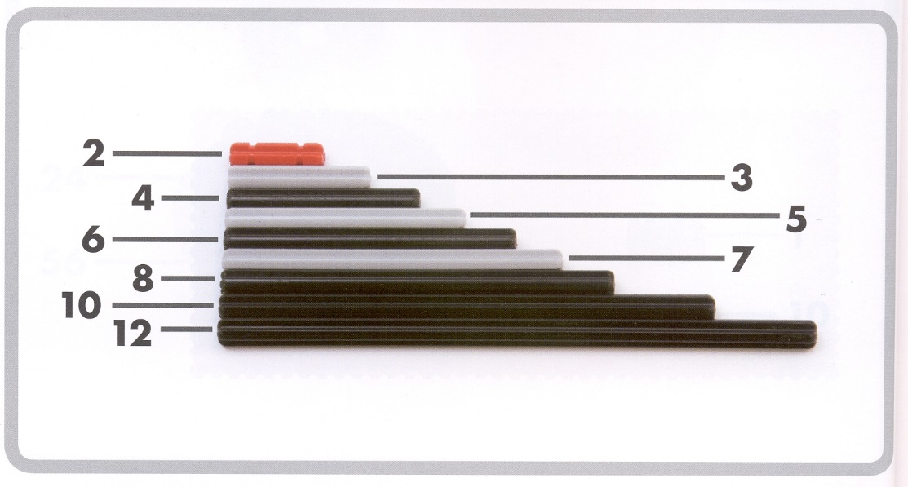
BEAM
13
2 Holes
3 Holes
3
Cross
2X = 2 PIECES

Slide 34
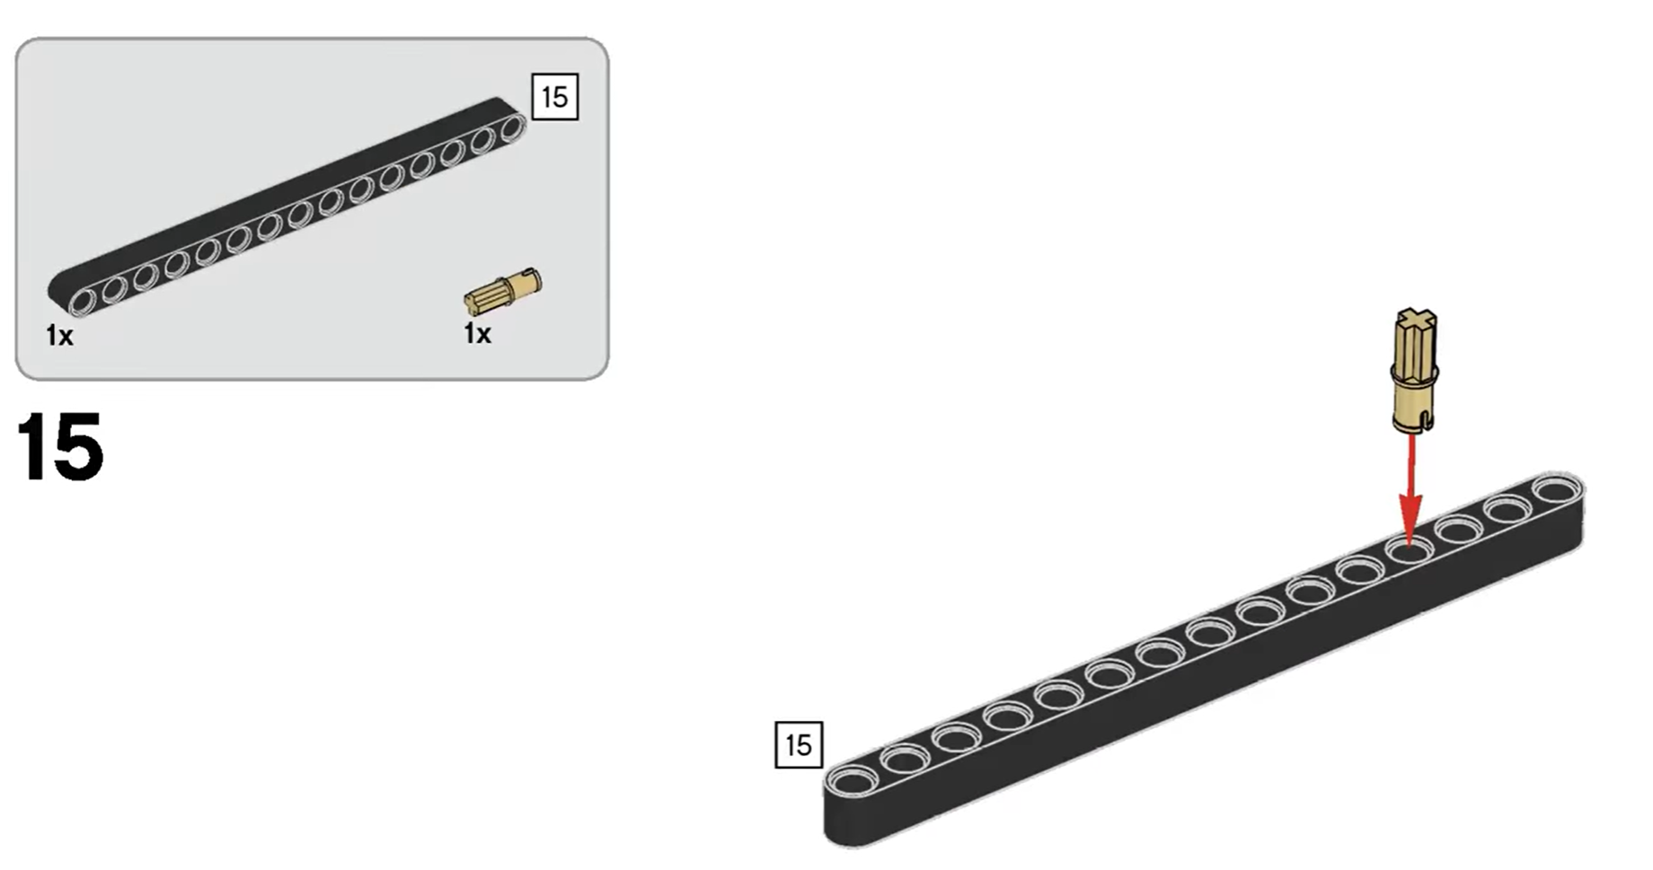

Slide 36

What is FIRST?
“Lunatic” Chicken
For
Inspiration and
Recognition of
Science and
Technology

Slide 37

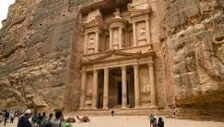
2. Innovative Project – 2025-2026 “Your Challenge is to identify a problem faced by archaeologists and propose a solution that can help.”
Research
Identify problem and new solution
Create model/drawing/prototype
5 minute presentation
Share solution with others/experts

Slide 38
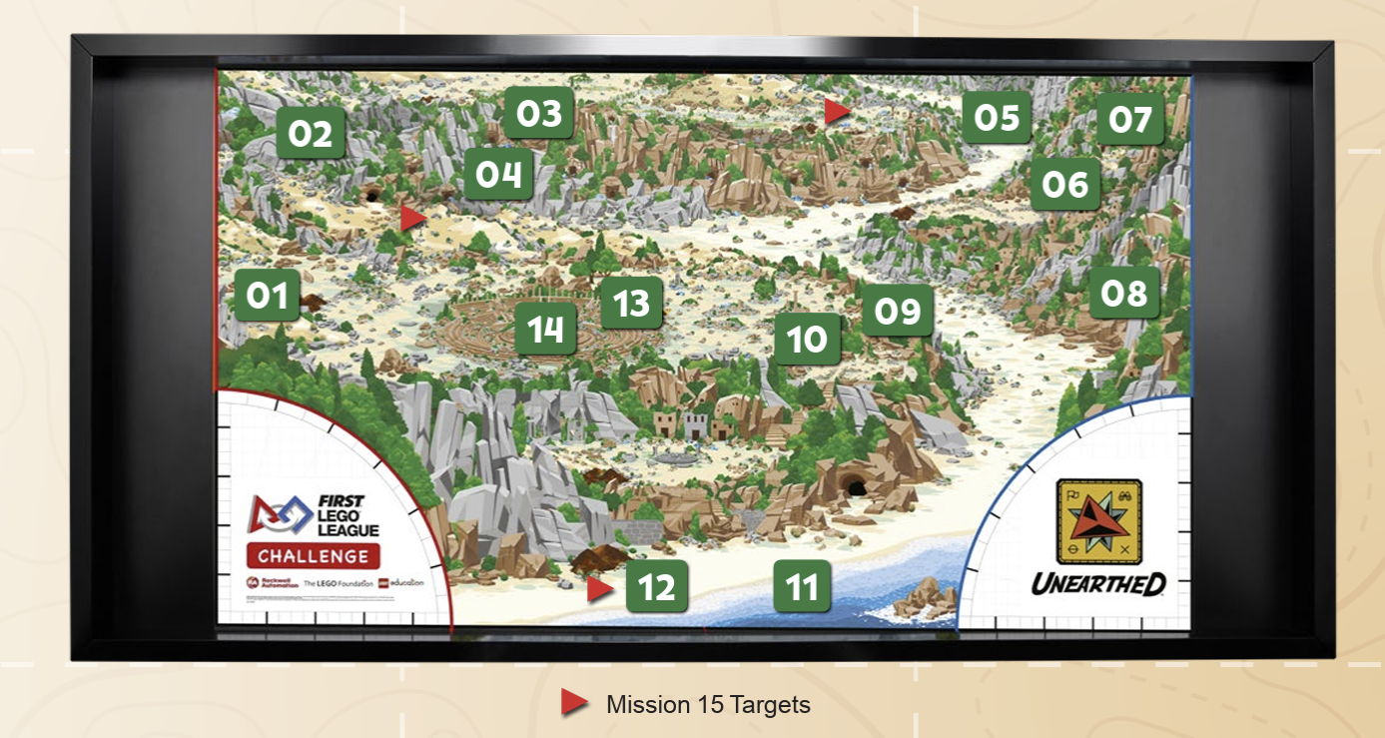
4. Robot Mission Board Game
2.5 Minutes
15 Missions
Team decides Strategy
Team selects Missions

Slide 39
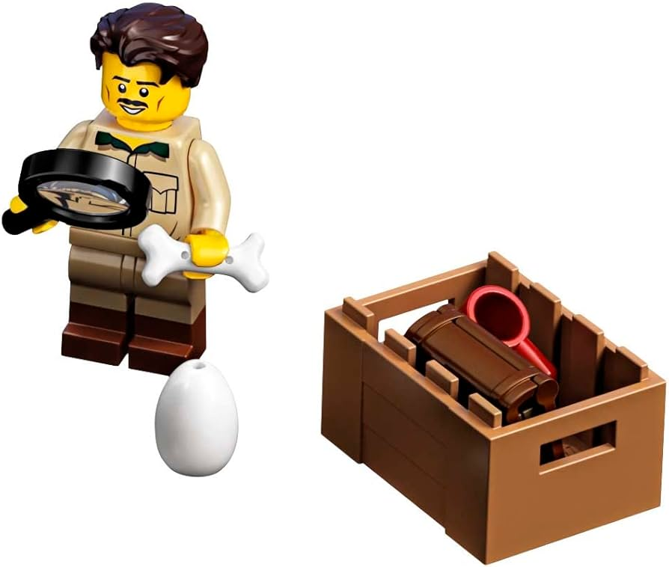
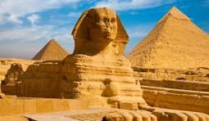
How Can We Help Our Teams?
Team members do the work – Only team members build the robot, code the robot, decide which missions to complete and the subject of their Innovative Project😊
Encouragement
Demonstrate new skills
Show coding and practice
Find experts
Research items
Ask questions

Slide 40
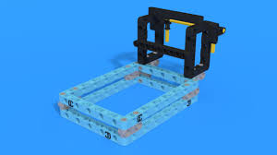
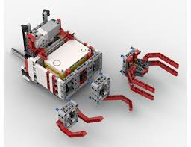

Attachments

